Slide 1
Biorefinery Öresund some reflexions. Bo Mattiasson Biotechnology, Lund University

Slide 2
Biorefinery needs many competences
Microbiology
Cell biology
Molecular biology
Fermentation technology
Process technology
Life cycle analysis
etc.

Slide 3
Interesting topic – big challenges
Where are the bottle necks?
Communication
Identification of targets
Choice of strategy
Equipment
Raw material

Slide 4
One can gather competencies ..
But equipment is difficult to finance
Running costs

Slide 7
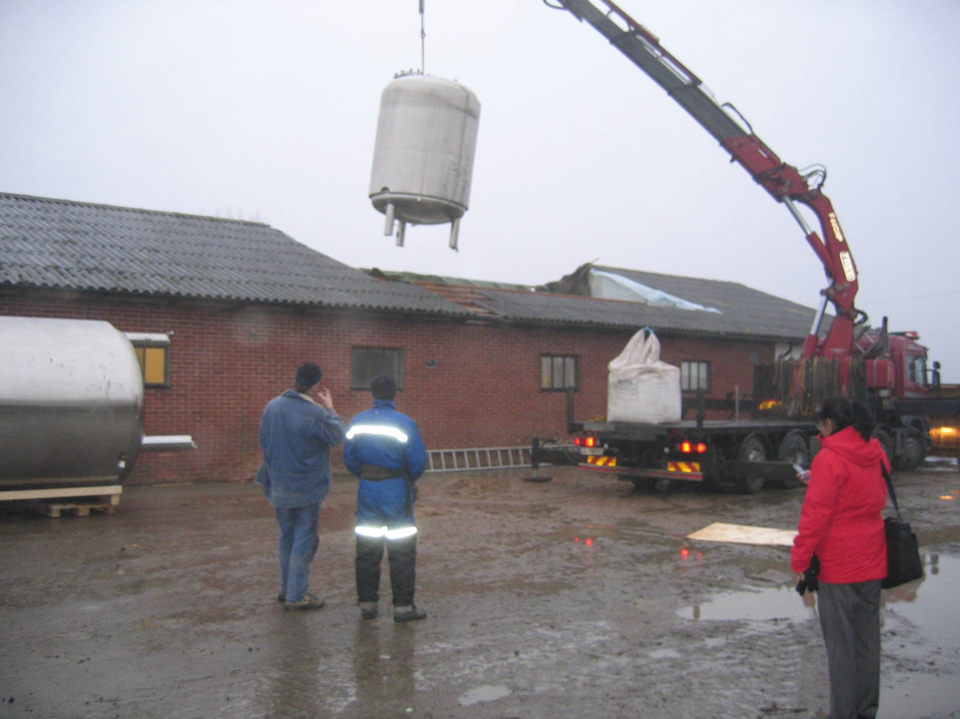

Slide 8
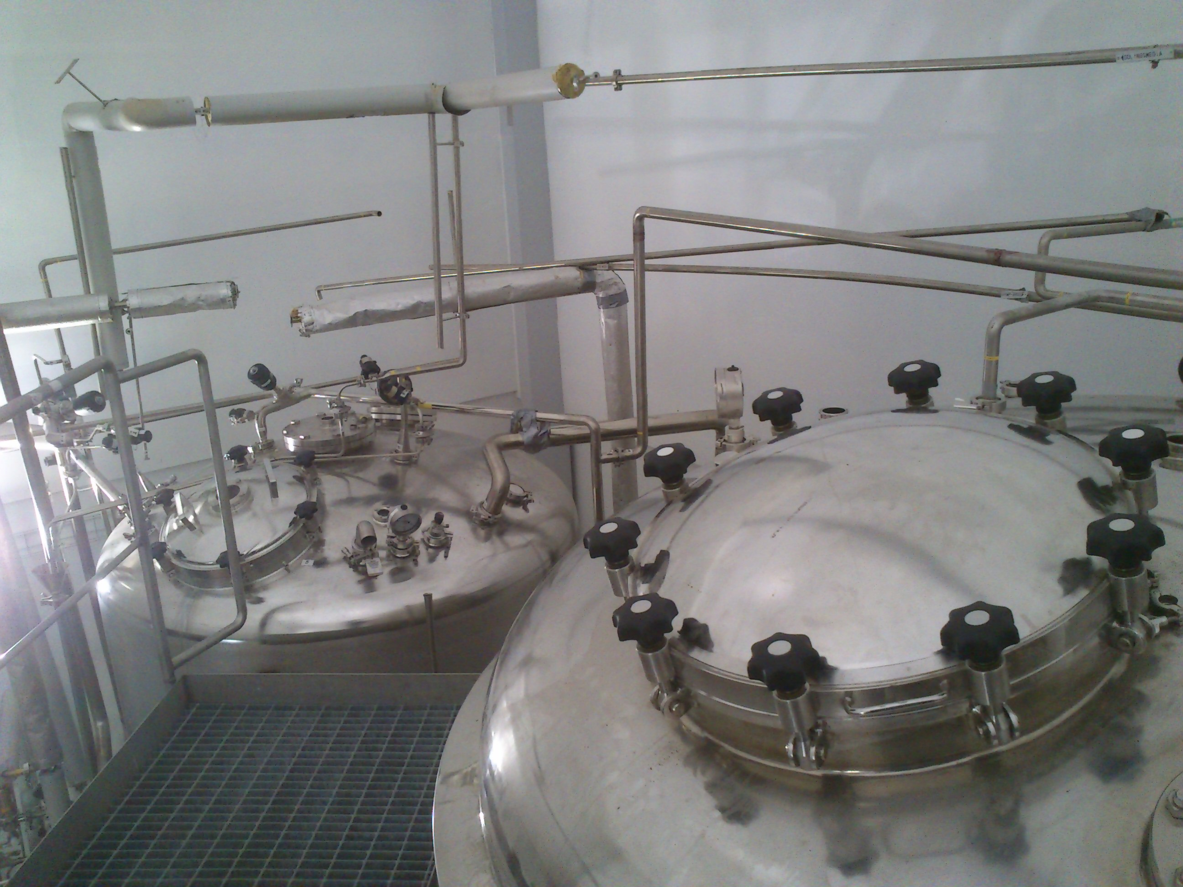

Slide 13
New crops
Jerusalem artichoke
Cikora

Slide 14
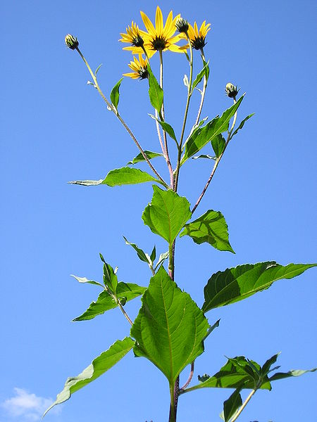
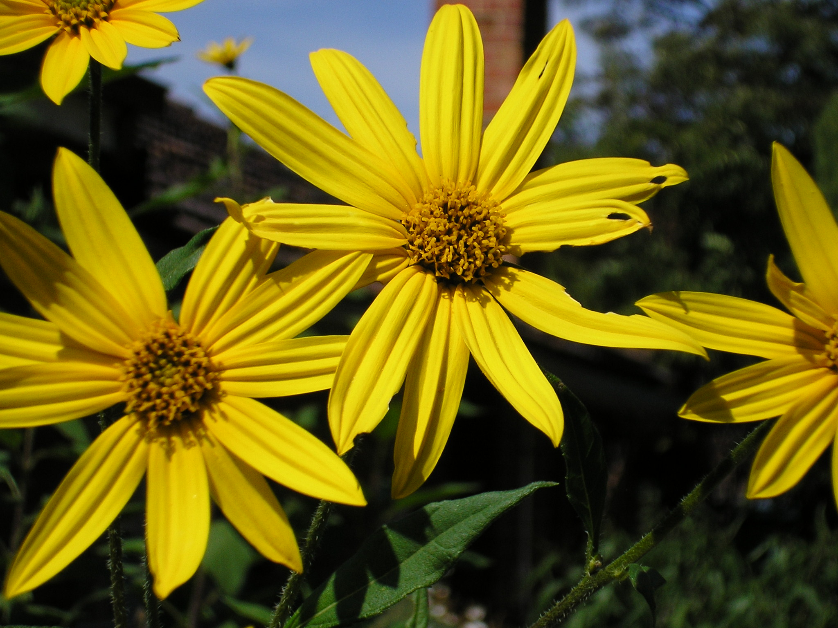
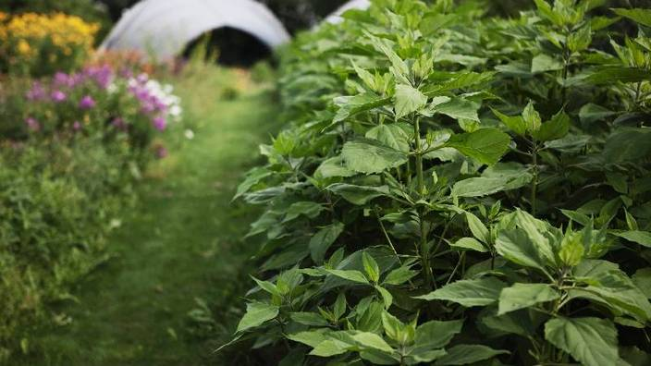
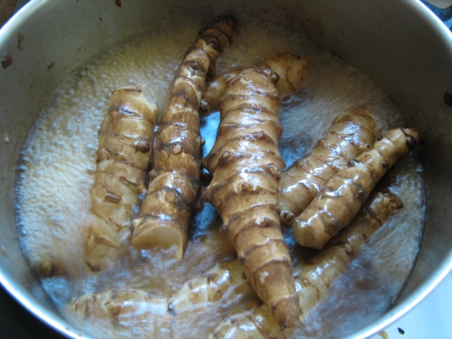

Slide 15
Pretreatment is a bottleneck!

Slide 16
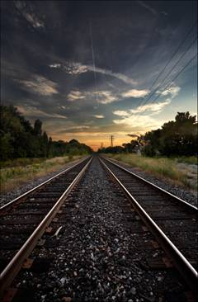
Two tracks…

Slide 17
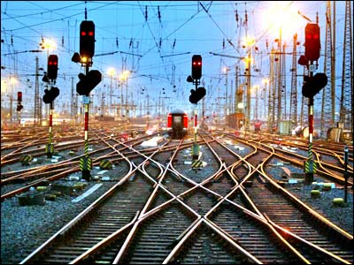
Two tracks… .. or more?

Slide 18
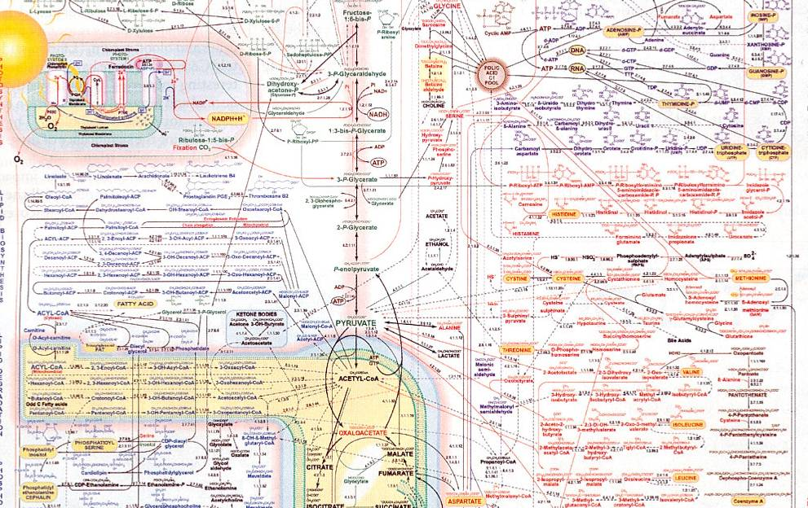
Det komplexa metaboliska nätverket:

Slide 19
Experiences
It takes some years before the team is fully coordinated
We are ready for new challenge – provided grants are available

Slide 20
Combine chemicals and energy carriers
Lactic acid + ethanol
If you combine and convert e.g. 20 % of the carbon source to lactic acid, then you can produce the ethanol so that the total economy allowing a competitive price for the ethanol

Slide 21
Combining chemicals and energy carriers
Start with the energy carrier– large and safe market, at a low price
Follow up with chemicals– more expensive products and a more difficult market

Slide 22
The combination of BIOREFINERY AND BIOGAS is attractive!

Slide 23
Pilot scale experiments
Propionic acid from glycerol and potato juice
Polyols from glycerol and potato juice

Slide 24
The biorefinery
It is in place!
Is a resource for academia and industry both in Denmark and Sweden!
Let us use it – it gives the region a unique opportunity!!

Slide 25
Special thanks to:
Josefin and earlier also Casper and their staff at Öresundsuniversitetet/LU Open
The advisory board

Slide 26
Special thanks to Interreg!
Supporting an “unconventional” application!
Continuous interest and support

