Slide 1
Øresund Biorefinery Project Oct. 2010 – Sept. 2013
Mhairi Workman
Department of Systems Biology
Technical University of Denmark

Slide 2
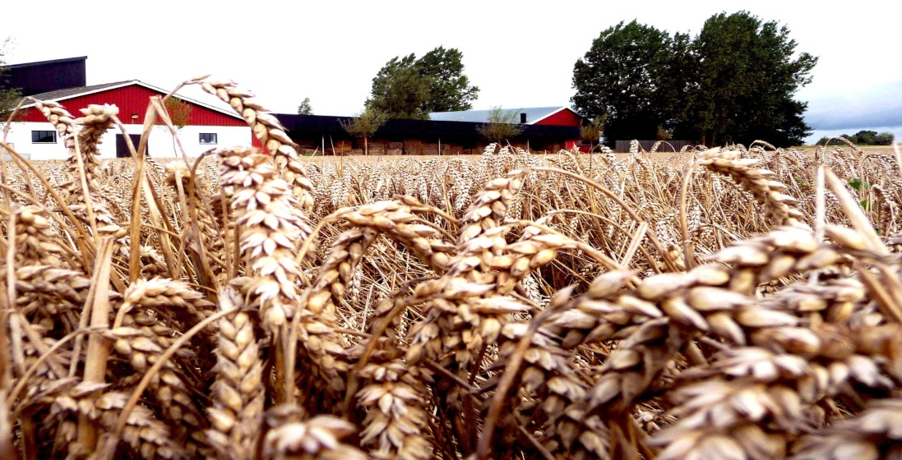
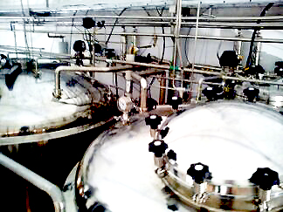
Sustainable production of value added products from locally available substrates in the Øresund region

Slide 3
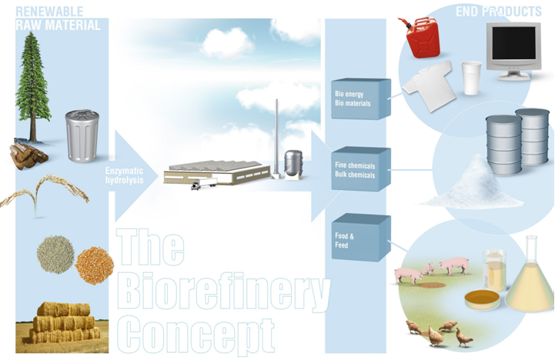
What is a biorefinery?
http://sv.wikipedia.org/wiki/Bioraffinaderi

Slide 4
Øresund Biorefinery
Selection and cultivation of crops
Selection and sourcing of waste materials
Pretreatment of substrates
Screening and selection of micro-organisms
Process design and optimisation
Life cycle/process assessment
Scale-up

Slide 5
Partners and locations
Scale-up Facility, Anneberg
Lund University
Biotechnology
Technology and Society
Technical University of Denmark
Systems Biology
Chemical Engineering
Environmental Engineering
Swedish Agricultural University
- Dept. of Agriculture

Slide 6
Product Selection and Handling
High value products
Process chain efficiency
Pretreatment
Start Materials
Selection of crops
Cultivation
Content Analysis
Conversion
Microorganisms
Process design
Engineering
Scale-up
- Selected processes
Life-cycle Analysis – Environmental and economic life cycle assessment guidedance

Slide 7
Start materials

Slide 8
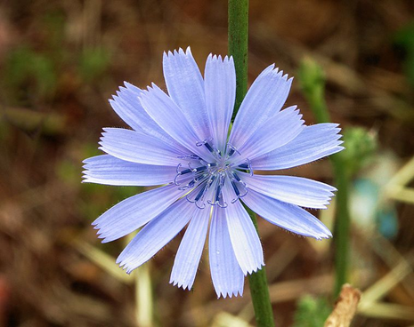
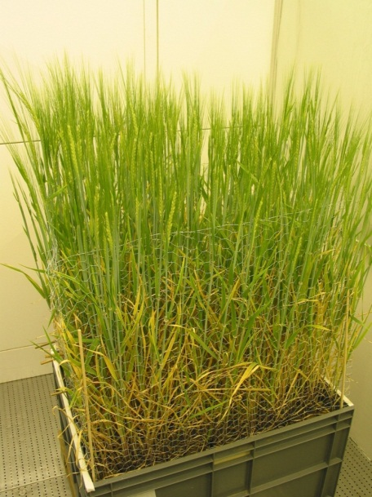
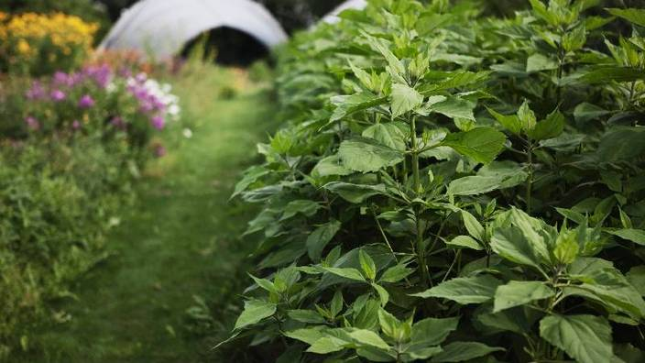
Substrate types
Hemp
Chicory
Wheat
Jerusalem artichoke
Glycerol

Slide 9
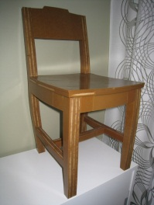
Substrate use
Wheat
Gluten recovery
Materials
Chicory
Inulin recovery
Jerusalem artichoke tubers
Pretreatment
Physical
Physiochemical
Lignocellulosic materials
Bioconversion/Fermentation
Products

Slide 10
Carbon composition after pretreatment
 | Glucose (g/L) | Xylose (g/L) | Glycerol (g/L) | Acetate (g/L) | Fructose (g/L)
Hemp | 9,8 | 8,1 | 6,1 | 2,5 | 0,0
Wheat bran | 3,0 | 4,4 | 0,0 | 0,3 | 0,0
Wheat bran Solid | 14,7 | 0,2 | 0,0 | 0,1 | 0,0
Jerusalem artichoke stems | 2 - 9 | 13 - 18 | - | - | 2 - 5
Jerusalem artichoke tubers | 10 | - | - | - | 15
One major challenge is the efficient release of available carbon from plant biomass feedstocks.
Necessity for efficient microbial hosts for bioconversions.

Slide 11
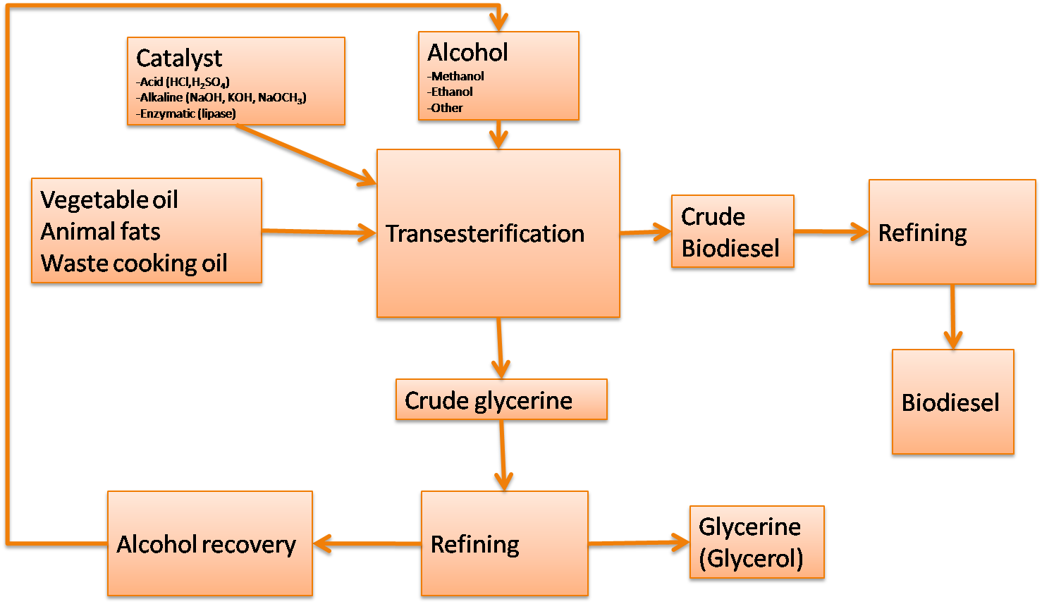
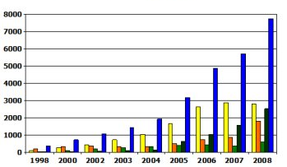
Glycerol as a substrate
Glycerol is the by-product of biodiesel production, produced at 10% the volume of biodiesel.

Slide 12
Conversion

Slide 13
Characteristics of desirable cell factories
Efficient growth
Efficient conversion of substrates
Lack of by-products
Tolerance to substrate and product
Cultivation at large scale
Amenable to genetic modification

Slide 14
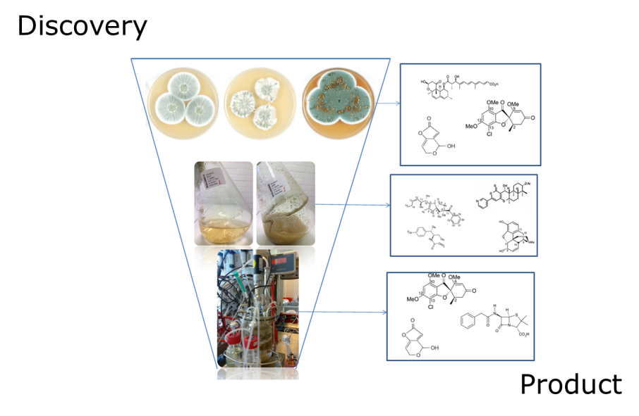
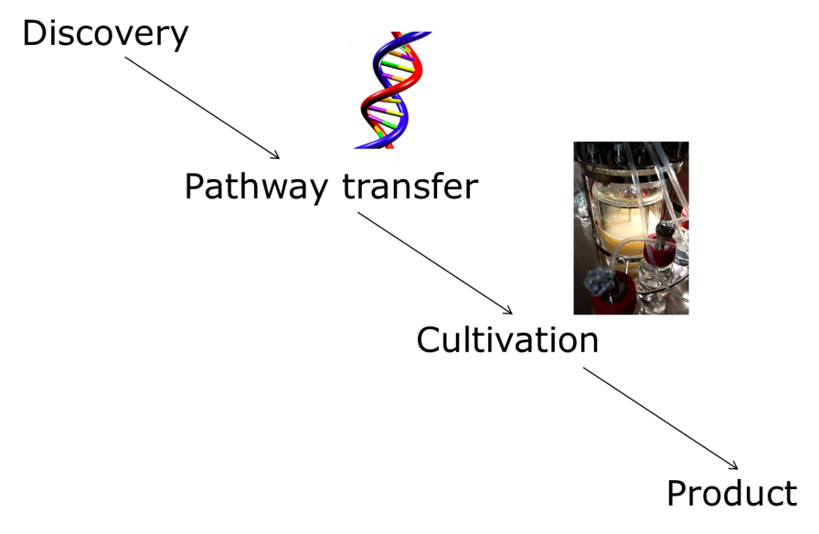
Two approaches to cell factory design
Fungal biodiversity
Quantitative physiology
Analytical Chemistry
Application of novel cell factories
Application of established cell factories
Bioinformatics
Mycology
Molecular Biology
Quantitative physiology
Analytical Chemistry

Slide 15
Glycerol as a substrate
Micro-organism | Products on glycerol | Reference
Candida magnoliae | Mannitol | Khan et al., 2009
Candida tropicalis | Ethanol | Lohmeier-Vogel and Hahn-Hägerdal, 1985
Candida utilis | Biomass | Fieldhouse et al, 2009
Debaromyces hansenii | Arabitol | Koganti et al., 2011
Hansenula polymorpha | Biomass, phytase, alcohol oxidase | Eggeling and Sam, 1980; Mayer et al., 1999
Pachysolen tannophilus | Ethanol | Maleszka et al, 1982; Liu et al, 2012
Pichia pastoris | Biomass, recombinant protein | Celik et al., 2008
Yarrowia lipolytica | Biomass, organic acids, polyols, lipids, α-amylase | Papanikolaou and Aggelis, 2002; Coelho et al, 2010

Slide 16
Mannitol production process
Batch cultivation at 1 litre scale. 50g/L glycerol, airflow control to ensure oxygen limitation.
Theoretical yield: 0.5 g/g glycerol
In flasks: 15g/L (Yield 0,46)
In Fermenters: 15g/L (Yield 0,36)
Resting cells in flasks: 10g/L (Yield 0,34)

Slide 17
Fed-batch mannitol process

Slide 18
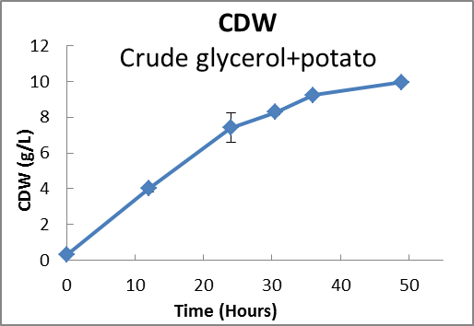
Crude substrates
Only crude substrates as nutrients, the strain is capable of growing and producing polyols and also accumulates intracellular lipids.

Slide 19
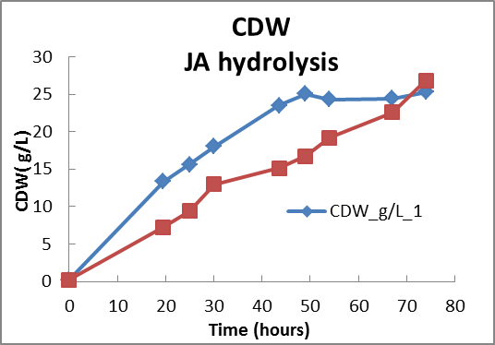
Jerusalem artichoke process
JA hydrolysate, with and without autoclavation, the strain is capable of growing and producing polyols (mainly mannitol).

Slide 20
Hemp hydrolysate
Complete utilisation of all carbon sources available. Very low amounts of products due to low concentration of carbon sources.

Slide 21
Summary
Locally available materials as substrates for bioprocesses
Versatile micro-organism applied
Relevant processes for scale-up/engineering
Other strategies – reverse engineering

Slide 22
Life Cycle Assessment

Slide 23
Raw material extraction
Inflow
Outflow
Raw material preparation
Material
Energy
Manufacturing
Emissions to air
Emissions to water
Waste
Other emissions
Transportation
Use
Recycling/Reuse
Disposal
The life-cycle of the product

Slide 24
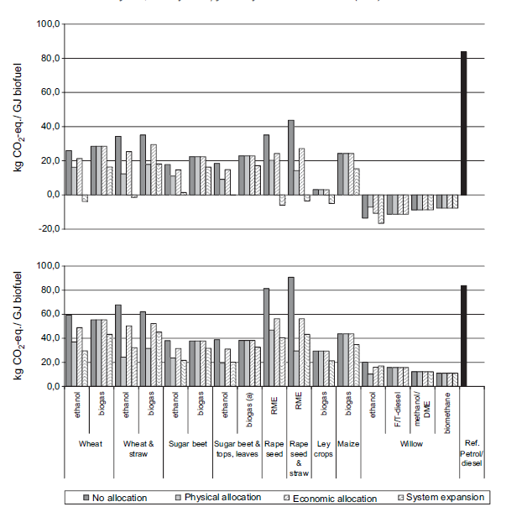
Raw material production – key paramters
Allocation method
Type of biomass
Removal of crop residues
N₂O emissions
Land use change

Slide 25
Process – key parameters
Yield
Process energy demand and primary energy source
Use of solvent
Toxicity

Slide 26
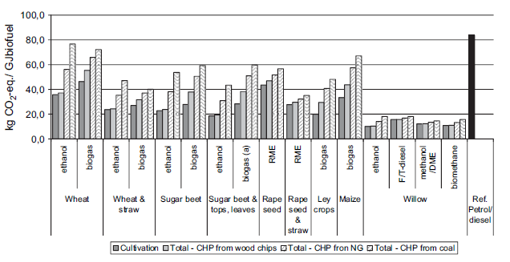
Process - key parameters
Primary energy source

Slide 27
Cultivation
Cultivation
Cultivation
Rapeseed
Potato
Roots
Food prod./ Ind. Appl.
Jerusalem artichoke
Biodiesel
prod.
Potato starch
Starch
prod.
Pretreatment and Hydrolysis
RME
Jerusalem artichoke tops and leaves
Glycerol
Potato juice
Fermentation
Fermentation
Fermentation
Down stream processing
Down stream processing
Down stream processing
Mannitol

Slide 28
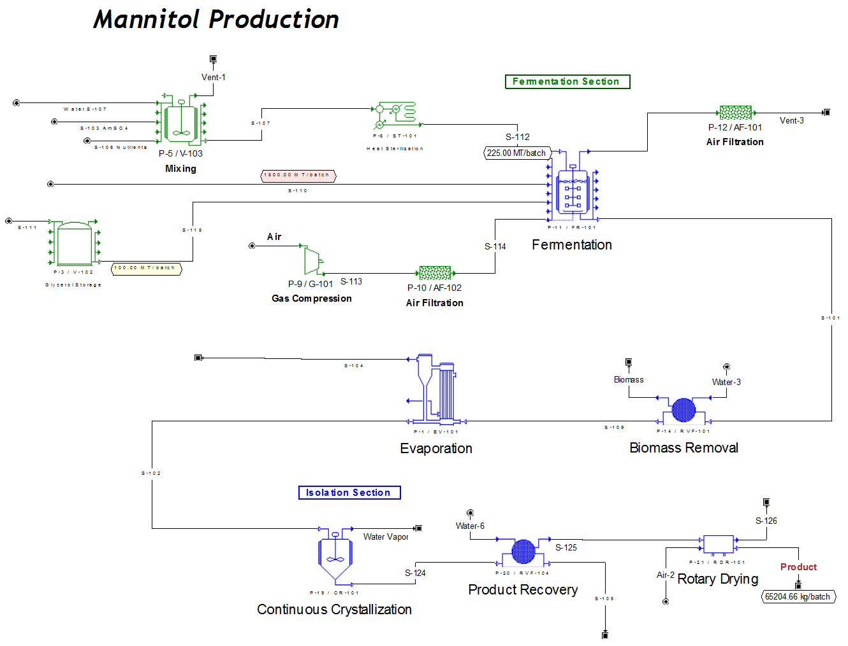

Slide 29
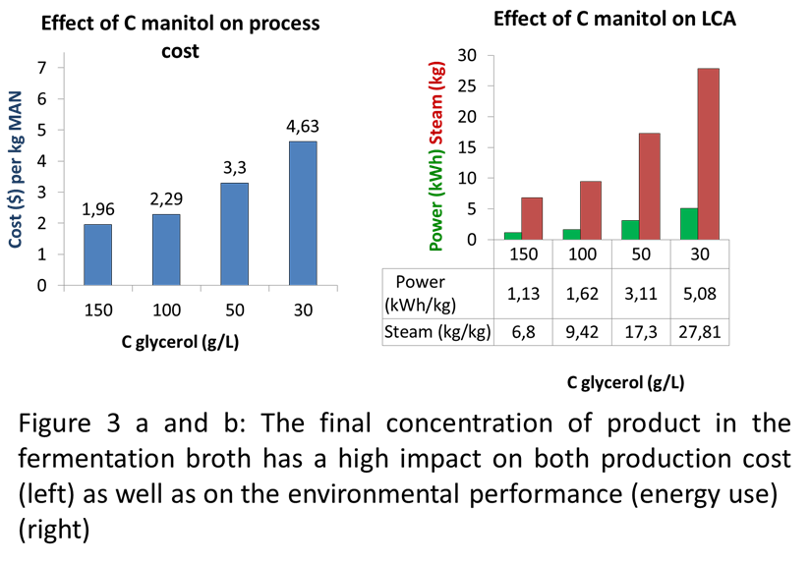
Economic Assessment

Slide 30
Communication and Network

Slide 31
Conference
Presentation at European Biomass Conference, Copenhagen, June 2013
Presentation at Physiology of Yeasts and Filamentous Fungi Conference, Montpellier, June 2013
Energitinget, June 2012
Presentation at 15th European Congress on Biotechnology, Istanbul, September 2012
Poster at Grøn Dyst, DTU, June 2012
Presentation at InnoAsia, Hong Kong, Nov 2011

Slide 32
Publications
Liu, X, Mortensen, U.H. and Workman, M. (2013). Expression and functional studies of genes involved in transport and metabolism of glycerol in Pachysolen tannophilus. Microbial Cell Factories 12: 27
Workman, M., Holt, P. and Thykaer, J. (2013) Comparing cellular performance of Yarrowia lipolytica during growth on glucose and glycerol in submerged cultivations . Under review AMB Express.
Rombouts I, Lagrain B, Delcour JA, Türe H, Hedenqvist MS, Johansson E, Kuktaite R (2013) Crosslinks in wheat gluten films with hexagonal close-packed protein structures. Ind Crops Prod. (accepted)
Newson WR, Kuktaite R, Hedenqvist MS, Gällstedt M, Johansson E (2013) Oilseed meal based plastics from plasticized, hot pressed Crambe abyssinica and Brassica carinata residuals. J Am Oil Chem Soc. 90:1229-1237.
Johansson E, Malik AH, Hussain A, Rasheed F, Newson WR, Plivelic T, Hedenqvist MS, Gällstedt M, Kuktaite R (2013) Wheat gluten polymer structures: The impact of genotype, environment and processing on their functionality in various applications. Cereal Chem. 90:367
Kuktaite R, Plivelic TS, Türe H, Hedenqvist MS, Gällstedt M, Marttila S, Johansson E (2012) Changes in the hierarchical protein polymer structure: urea and temperature effects on wheat gluten films. RSC Advances 2:11908-11914

Slide 33
Biorefinery Network
Øresund Biorefinery conference, Lund, October 2011
Collaboration with Öresundsklassrummet
Collaboration with plastic industry, 2011-2013
Inauguration of pilot scale biorefinery, Anneberg, June 2012
Workshop with Sustainable Business Hub, September 2012
Workshop at Nordic Sugar, October 2012
Workshop for Swedish and Danish Farmers, May 2013
CleanTech Bazaar, May 2013
Biorefinery in the Øresund region seminar, June 2013
Workshop at Symbiosis Center, Kalundborg, August 2013

