Slide 1
WEC Energy Issues Monitor 2013
Leif Sønderberg Petersen
Secretary General
World Energy Council - Denmark

Slide 2
World Energy Council – what we do
Network of leaders and practitioners promoting an sustainable, affordable, stable and environmentally sensitive energy system for the greatest benefit of all.
Formed in 1923, we are the UN-accredited global energy body.
3000 member organisations in over 90 countries.
Members comes from governments, private and state corporations, academia, NGOs and other energy-related stakeholders.

Slide 3
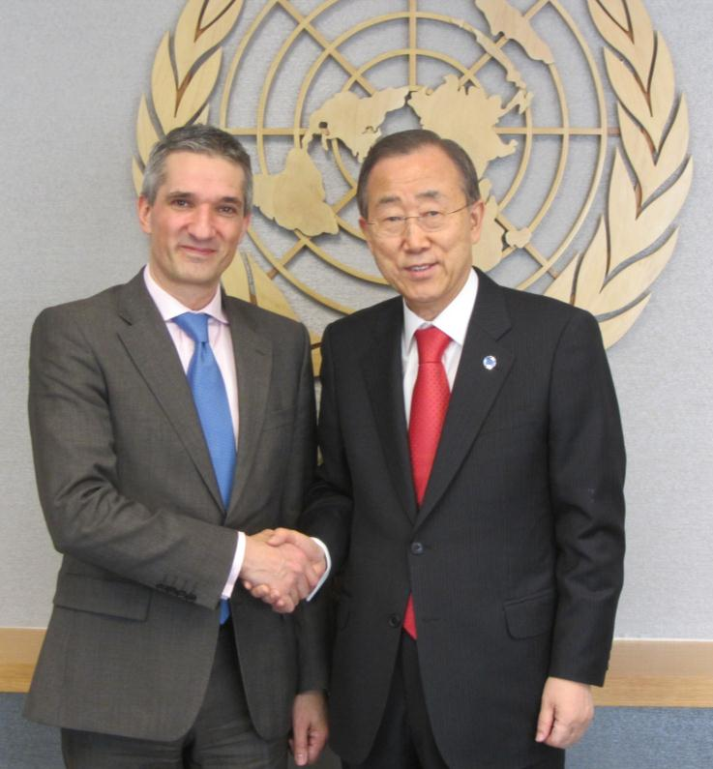
Information on global, regional and national energy strategies
WEC works with governments, agencies and companies on policy development and strategic decision-making and planning.
WEC works with partner organisations to facilitate
access to our network of experts
impartial advice to intergovernmental organisations
and national governments
on specific issues affecting what we call the Energy Trilemma.

Slide 4
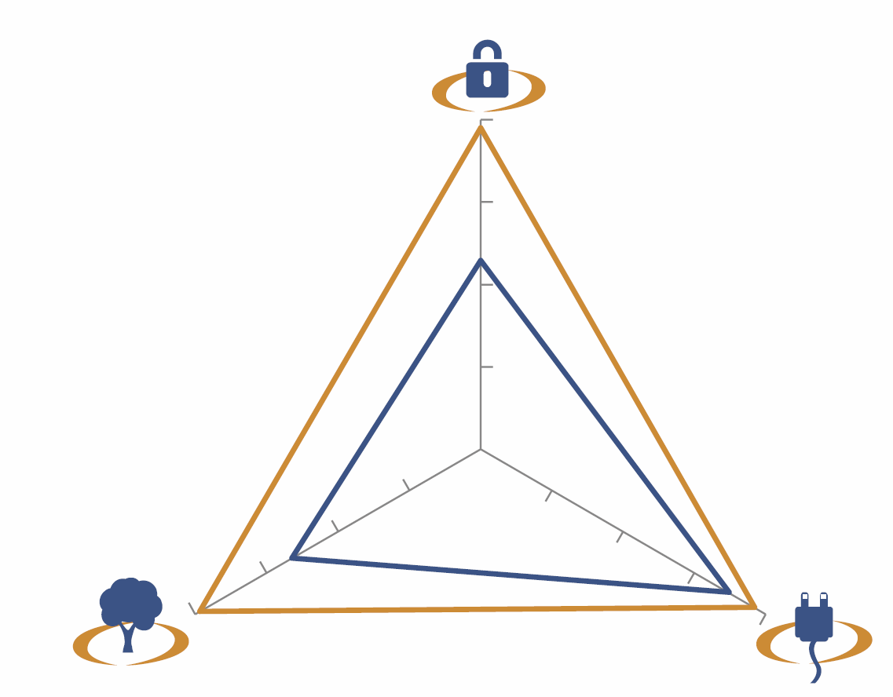
The Energy Trilemma
Energy security
Energy security. The effective management of primary energy supply from domestic and external sources; the reliability of energy infrastructure; and the ability of participating energy companies to meet current and future demand.
Social equity. This concerns the accessibility and affordability of energy supply across the population.
Environmental impact mitigation. This encompasses the achievement of supply and demand-side of energy efficiencies and the development of energy supply from renewable and other low-carbon sources.
Environmental
impact mitigation
Social equity

Slide 5
High-level events
World Energy Congress every three years. The world’s largest energy event.
World Energy Leaders’ Summits (WELS) twice a year to enable an ongoing high-level dialogue on critical issues affecting the energy world.
Regional events annually or bi-annually. They are organised by the WEC’s national member committees working in partnership.
National events are organised regularly by the national member committees.

Slide 6
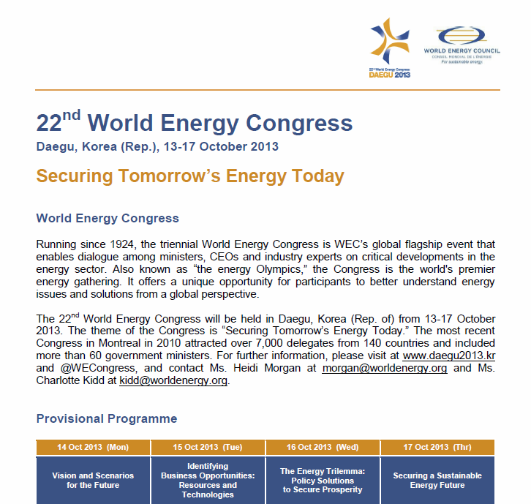
There is still time to register

Slide 7
Authoritative studies
World Energy Resources, a survey of global resources and technologies.
World Energy Trilemma report, an independent assessment of national energy and climate policies.
World Energy Issues Monitor, an annual monitor identifying what issues are affecting the global energy leaders’ community.
World Energy Scenarios, in-depth explorative energy scenarios, e.g. Global Transport Scenarios 2050.

Slide 8
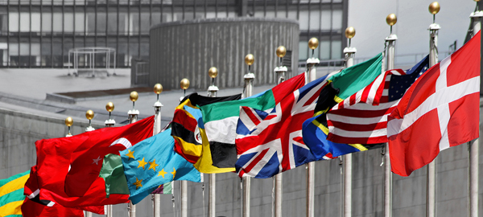
WEC Denmark is working for:
Disseminate information from the WEC to its members and other decision makers in the energy sector.
Increase members' knowledge of international energy issues.
Putting Danish energy policy in international perspective.
Support the Danish participation in the international work of WEC.
Promote international understanding of Danish energy policies.
Contribute to increased cooperation between the energy sector actors.

Slide 9
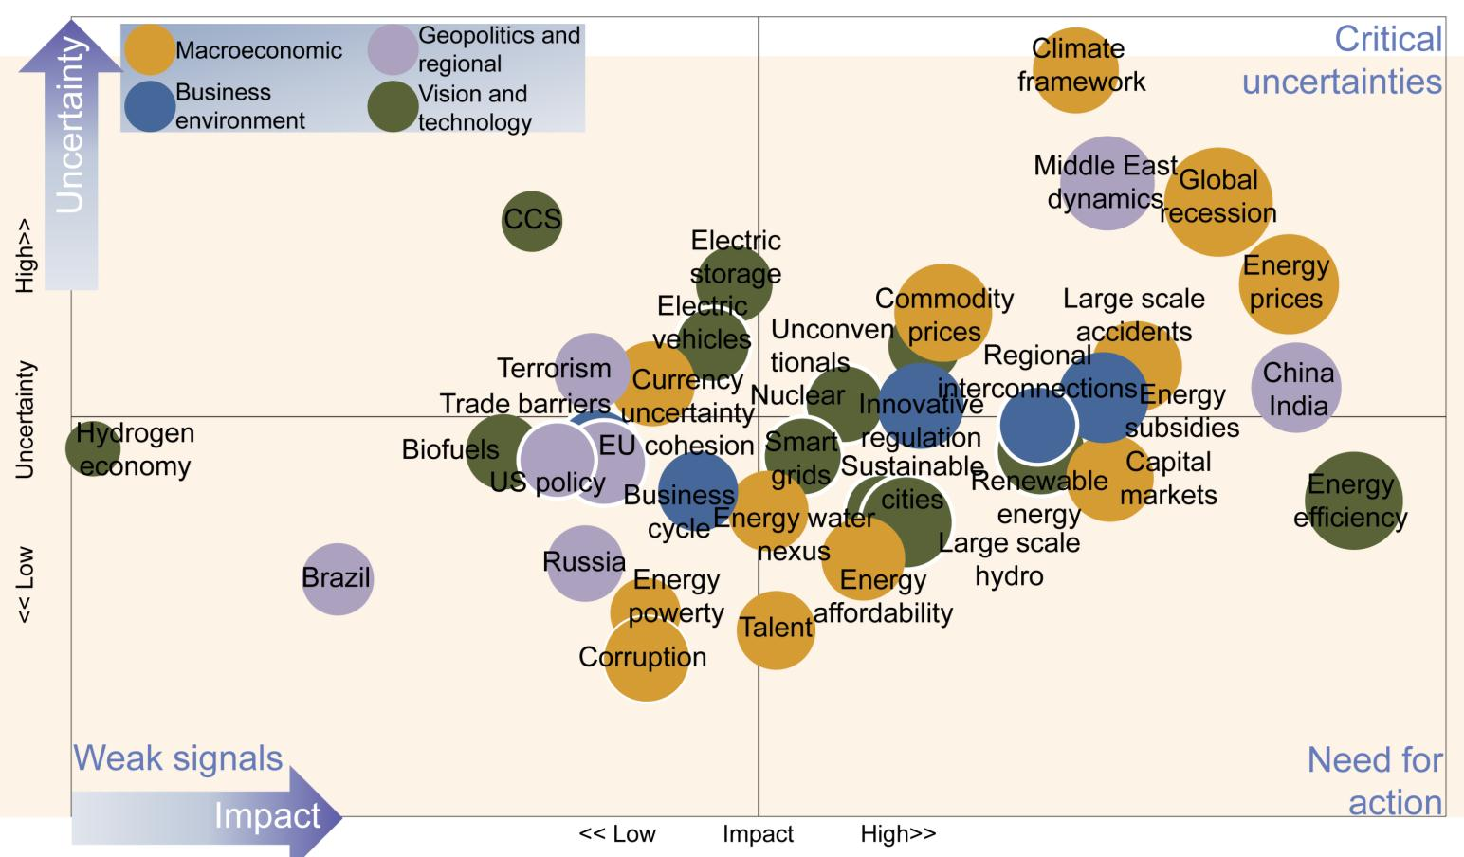
World Energy Issues Monitor
Based on annual survey among the Member Committees of WEC
Includes 36 issues covering
Macroeconomic risks
Geopolitics
Business environment
Energy technology development
It reflects the views and insights of ministers, CEOs, and leading experts in the nearly 100 countries that represent the WEC community.

Slide 10
Issues Monitor: how to read?
The urgency of an issue is proportional to the size of its bubble.
Urgency
Four different categories of issues represented in four different colours:
Macroeconomic risks
Energy geopolitics
Energy policies and business environment
Energy technology development

Slide 11
Issues Monitor: how to read?
Critical
uncertainties
Issues with high uncertainty and high impact, and which will most benefit from energy leaders’ dialogue and scenario analysis
Uncertainty
Issues with low impact and low uncertainty which are perceived to be less important, but which may also be issues that are still badly understood
<< Low Uncertainty High>>
Issues with high impact and low uncertainty, where immediate action finds easy consensus
Weak signals
Need for
action
Impact
<< Low Impact High>>

Slide 12
Macroeconomic risks
Global climate framework uncertainty
Uncertainty on outcome and time-horizon of global climate negotiations, i.e. the question whether there will be a global/ regional price on CO₂ and if so, at what level that price would be.
Climate
framework
Critical
uncertainties
Uncertainty
<< Low Uncertainty High>>
Weak signals
Need for
action
Impact
<< Low Impact High>>
Notes:
Commodity prices = råvarepriser
Currency uncertainty = valutausikkerhed
Energy water nexus = energi vand sammenhæng

Slide 13
Macroeconomic risks
Large scale accidents
Post Fukushima nuclear disaster and Deepwater Horizon oil spill: possibility of potential further energy related large scale accidents and implications of changes in governance and safety standards to avoid these.
Climate
framework
Critical
uncertainties
Uncertainty
Large scale
accidents
<< Low Uncertainty High>>
Weak signals
Need for
action
Impact
<< Low Impact High>>
Notes:
Commodity prices = råvarepriser
Currency uncertainty = valutausikkerhed
Energy water nexus = energi vand sammenhæng

Slide 14
Macroeconomic risks
Global recession
Implication of recession, including e.g. relative decoupling of global economy, impact on subsidies for and trade of green goods.
Climate
framework
Critical
uncertainties
Uncertainty
Global
recession
Large scale
accidents
<< Low Uncertainty High>>
Weak signals
Need for
action
Impact
<< Low Impact High>>
Notes:
Commodity prices = råvarepriser
Currency uncertainty = valutausikkerhed
Energy water nexus = energi vand sammenhæng

Slide 15
Macroeconomic risks
Capital market constraints
Difficult matching of capital to deliver energy infrastructure
Climate
framework
Critical
uncertainties
Uncertainty
Global
recession
Large scale
accidents
<< Low Uncertainty High>>
Capital
markets
Weak signals
Need for
action
Impact
<< Low Impact High>>
Notes:
Commodity prices = råvarepriser
Currency uncertainty = valutausikkerhed
Energy water nexus = energi vand sammenhæng

Slide 16
Macroeconomic risks
Commodity prices & volatility
High prices, volatility & inflationary risk
Climate
framework
Critical
uncertainties
Uncertainty
Global
recession
Commodity
prices
Large scale
accidents
<< Low Uncertainty High>>
Capital
markets
Weak signals
Need for
action
Impact
<< Low Impact High>>
Notes:
Commodity prices = råvarepriser
Currency uncertainty = valutausikkerhed
Energy water nexus = energi vand sammenhæng

Slide 17
Macroeconomic risks
Energy prices & volatility
High volatility & investment uncertainty (“security of demand” concern)
Climate
framework
Critical
uncertainties
Uncertainty
Global
recession
Energy
prices
Commodity
prices
Large scale
accidents
<< Low Uncertainty High>>
Capital
markets
Weak signals
Need for
action
Impact
<< Low Impact High>>
Notes:
Commodity prices = råvarepriser
Currency uncertainty = valutausikkerhed
Energy water nexus = energi vand sammenhæng

Slide 18
Macroeconomic risks
Currency uncertainty
Exchange rate, insolvency and currency devaluation risks negatively impacting energy infrastructure investments
Climate
framework
Critical
uncertainties
Uncertainty
Global
recession
Energy
prices
Commodity
prices
Large scale
accidents
Currency
uncertainty
<< Low Uncertainty High>>
Capital
markets
Weak signals
Need for
action
Impact
<< Low Impact High>>
Notes:
Commodity prices = råvarepriser
Currency uncertainty = valutausikkerhed
Energy water nexus = energi vand sammenhæng

Slide 19
Macroeconomic risks
Energy-water-food nexus
Energy-water(-food) nexus exposing energy supply chain to risks regarding changing water availability and policies to combat hunger
Climate
framework
Critical
uncertainties
Uncertainty
Global
recession
Energy
prices
Commodity
prices
Large scale
accidents
Currency
uncertainty
<< Low Uncertainty High>>
Capital
markets
Energy water
nexus
Weak signals
Need for
action
Impact
<< Low Impact High>>
Notes:
Commodity prices = råvarepriser
Currency uncertainty = valutausikkerhed
Energy water nexus = energi vand sammenhæng

Slide 20
Macroeconomic risks
Talent scarcity
Shortage of future engineering or other energy relevant skills negatively affecting energy infrastructure development and expansion
Climate
framework
Critical
uncertainties
Uncertainty
Global
recession
Energy
prices
Commodity
prices
Large scale
accidents
Currency
uncertainty
<< Low Uncertainty High>>
Capital
markets
Energy water
nexus
Talent
Weak signals
Need for
action
Impact
<< Low Impact High>>
Notes:
Commodity prices = råvarepriser
Currency uncertainty = valutausikkerhed
Energy water nexus = energi vand sammenhæng

Slide 21
Macroeconomic risks
Energy poverty
1.3 billion people are still without access to electricity, 87% in rural areas; new entrepreneurial models, creation of financing mechanisms, focused government policies to deliver solutions
Climate
framework
Critical
uncertainties
Uncertainty
Global
recession
Energy
prices
Commodity
prices
Large scale
accidents
Currency
uncertainty
<< Low Uncertainty High>>
Capital
markets
Energy water
nexus
Energy
powerty
Talent
Weak signals
Need for
action
Impact
<< Low Impact High>>
Notes:
Commodity prices = råvarepriser
Currency uncertainty = valutausikkerhed
Energy water nexus = energi vand sammenhæng

Slide 22
Macroeconomic risks
Energy affordability
Also referred to “fuel poverty”, high or increasing energy prices weighing on the household budgets
Climate
framework
Critical
uncertainties
Uncertainty
Global
recession
Energy
prices
Commodity
prices
Large scale
accidents
Currency
uncertainty
<< Low Uncertainty High>>
Capital
markets
Energy water
nexus
Energy
affordability
Energy
powerty
Talent
Weak signals
Need for
action
Impact
<< Low Impact High>>
Notes:
Commodity prices = råvarepriser
Currency uncertainty = valutausikkerhed
Energy water nexus = energi vand sammenhæng

Slide 23
Macroeconomic risks
Corruption
Slowing down development and development of effective policies.
Climate
framework
Critical
uncertainties
Uncertainty
Global
recession
Energy
prices
Commodity
prices
Large scale
accidents
Currency
uncertainty
<< Low Uncertainty High>>
Capital
markets
Energy water
nexus
Energy
affordability
Energy
powerty
Talent
Corruption
Weak signals
Need for
action
Impact
<< Low Impact High>>
Notes:
Commodity prices = råvarepriser
Currency uncertainty = valutausikkerhed
Energy water nexus = energi vand sammenhæng

Slide 24
Energy geopolitics
China/India growth
Shifting demand to east, competition for scarce resources, market uncertainties and sustainability of continued growth rates.
Critical
uncertainties
Uncertainty
China
India
<< Low Uncertainty High>>
Weak signals
Need for
action
Impact
<< Low Impact High>>
Notes:
EU cohesion = EU sammenhængskraft

Slide 25
Energy geopolitics
Brazil realising its potential as role model for Latin America
Realising its potential, influence on regional policy, growth and development within the region
Critical
uncertainties
Uncertainty
China
India
<< Low Uncertainty High>>
Brazil
Weak signals
Need for
action
Impact
<< Low Impact High>>
Notes:
EU cohesion = EU sammenhængskraft

Slide 26
Energy geopolitics
Russia energy diplomacy
Ability to adapt to shale gas context and maintain its importance in the natural gas sector; implications for regional / global gas markets.
Critical
uncertainties
Uncertainty
China
India
<< Low Uncertainty High>>
Brazil
Russia
Weak signals
Need for
action
Impact
<< Low Impact High>>
Notes:
EU cohesion = EU sammenhængskraft

Slide 27
Energy geopolitics
EU cohesion
Absence of common energy policy with negative effects on common energy market and regional interconnection
Critical
uncertainties
Uncertainty
China
India
<< Low Uncertainty High>>
EU cohesion
Brazil
Russia
Weak signals
Need for
action
Impact
<< Low Impact High>>
Notes:
EU cohesion = EU sammenhængskraft

Slide 28
Energy geopolitics
Middle East / North Africa fragility
Political fragility and potential conflict (e.g. around Suez Canal) affecting global security of supply.
Critical
uncertainties
Uncertainty
Middle East
dynamics
China
India
<< Low Uncertainty High>>
EU cohesion
Brazil
Russia
Weak signals
Need for
action
Impact
<< Low Impact High>>
Notes:
EU cohesion = EU sammenhængskraft

Slide 29
Energy geopolitics
US trade and policy influencing global energy markets
US driven innovation and policy influencing global energy trade; and affecting priorities in bilateral relations and international security policies
Critical
uncertainties
Uncertainty
Middle East
dynamics
China
India
<< Low Uncertainty High>>
US policy
EU cohesion
Brazil
Russia
Weak signals
Need for
action
Impact
<< Low Impact High>>
Notes:
EU cohesion = EU sammenhængskraft

Slide 30
Energy geopolitics
Terrorism
Physical risks and cyber threats affecting energy markets
Critical
uncertainties
Uncertainty
Middle East
dynamics
Terrorism
China
India
<< Low Uncertainty High>>
US policy
EU cohesion
Brazil
Russia
Weak signals
Need for
action
Impact
<< Low Impact High>>
Notes:
EU cohesion = EU sammenhængskraft

Slide 31
Energy policies and business environment
Trade barriers
Constraining or enabling green growth (e.g. through technology transfer or the lack thereof)
Critical
uncertainties
Uncertainty
<< Low Uncertainty High>>
Trade barriers
Weak signals
Need for
action
Impact
<< Low Impact High>>

Slide 32
Energy policies and business environment
Regional interconnection
Underdevelopment of regional infrastructure, potentially high cost implications of unequal distribution of resources
Critical
uncertainties
Uncertainty
<< Low Uncertainty High>>
Trade barriers
Regional
interconnections
Weak signals
Need for
action
Impact
<< Low Impact High>>

Slide 33
Energy policies and business environment
Business cycle
Overcapacity and underinvestment in energy infrastructure as a growth constraint
Critical
uncertainties
Uncertainty
<< Low Uncertainty High>>
Trade barriers
Regional
interconnections
Business
cycle
Weak signals
Need for
action
Impact
<< Low Impact High>>

Slide 34
Energy policies and business environment
Innovative market design & policies
New market designs and policies securing back-up and storage capacity in electricity markets with increasing intermittent renewable energy shares; fragmented regulation leading to ineffective solutions
Critical
uncertainties
Uncertainty
Innovative
regulation
<< Low Uncertainty High>>
Trade barriers
Regional
interconnections
Business
cycle
Weak signals
Need for
action
Impact
<< Low Impact High>>

Slide 35
Energy policies and business environment
Energy subsidies
Uncertainty over subsidy sustainability
Critical
uncertainties
Uncertainty
Energy
subsidies
Innovative
regulation
<< Low Uncertainty High>>
Trade barriers
Regional
interconnections
Business
cycle
Weak signals
Need for
action
Impact
<< Low Impact High>>

Slide 36
Energy technology development
Sustainable cities
Realising resource efficient urbanisation at scale
Critical
uncertainties
Uncertainty
<< Low Uncertainty High>>
Sustainable
cities
Weak signals
Need for
action
Impact
<< Low Impact High>>

Slide 37
Energy technology development
Energy efficiency
Overcoming barriers to implementation and achieve its potential
Critical
uncertainties
Uncertainty
<< Low Uncertainty High>>
Sustainable
cities
Energy
efficiency
Weak signals
Need for
action
Impact
<< Low Impact High>>

Slide 38
Energy technology development
Carbon capture, utilisation & storage (CCUS)
Overcoming barriers to achieving scale, innovative solutions to make projects viable (enhanced oil recovery, CO2-to-plastic, CO2-to-algae/biofuels)
Critical
uncertainties
Uncertainty
CCS
<< Low Uncertainty High>>
Sustainable
cities
Energy
efficiency
Weak signals
Need for
action
Impact
<< Low Impact High>>

Slide 39
Energy technology development
Renewable energy
Maintaining traction to achieving scale
Critical
uncertainties
Uncertainty
CCS
<< Low Uncertainty High>>
Renewable
energy
Sustainable
cities
Energy
efficiency
Weak signals
Need for
action
Impact
<< Low Impact High>>

Slide 40
Energy technology development
Biofuels
Overcoming barriers to realising potential
Critical
uncertainties
Uncertainty
CCS
<< Low Uncertainty High>>
Renewable
energy
Biofuels
Sustainable
cities
Energy
efficiency
Weak signals
Need for
action
Impact
<< Low Impact High>>

Slide 41
Energy technology development
Smartgrids
Decentralised solutions and business models taken to scale
Critical
uncertainties
Uncertainty
CCS
<< Low Uncertainty High>>
Smart
grids
Renewable
energy
Biofuels
Sustainable
cities
Energy
efficiency
Weak signals
Need for
action
Impact
<< Low Impact High>>

Slide 42
Energy technology development
Future mobility
Innovative motility concepts, new transportation modes and fuel sources including electric vehicles, natural gas vehicles realising potential
Critical
uncertainties
Uncertainty
CCS
Electric
vehicles
<< Low Uncertainty High>>
Smart
grids
Renewable
energy
Biofuels
Sustainable
cities
Energy
efficiency
Weak signals
Need for
action
Impact
<< Low Impact High>>

Slide 43
Energy technology development
Electricity storage
Cheaper batteries, “power to gas” storage (of excess generation from renewables) and scalability
Critical
uncertainties
Uncertainty
CCS
Electric
storage
Electric
vehicles
<< Low Uncertainty High>>
Smart
grids
Renewable
energy
Biofuels
Sustainable
cities
Energy
efficiency
Weak signals
Need for
action
Impact
<< Low Impact High>>

Slide 44
Energy technology development
Nuclear
Future of nuclear post-Fukushima
Critical
uncertainties
Uncertainty
CCS
Electric
storage
Electric
vehicles
Nuclear
<< Low Uncertainty High>>
Smart
grids
Renewable
energy
Biofuels
Sustainable
cities
Energy
efficiency
Weak signals
Need for
action
Impact
<< Low Impact High>>

Slide 45
Energy technology development
Hydro power
Overcoming barriers to realising potential
Critical
uncertainties
Uncertainty
CCS
Electric
storage
Electric
vehicles
Nuclear
<< Low Uncertainty High>>
Smart
grids
Renewable
energy
Biofuels
Sustainable
cities
Energy
efficiency
Large scale
hydro
Weak signals
Need for
action
Impact
<< Low Impact High>>

Slide 46
Energy technology development
Unconventional fossil fuels
Shale gas, oil shale, potentially other unconventionals realising potential, altering global oil & gas market dynamics
Critical
uncertainties
Uncertainty
CCS
Electric
storage
Electric
vehicles
Unconventionals
Nuclear
<< Low Uncertainty High>>
Smart
grids
Renewable
energy
Biofuels
Sustainable
cities
Energy
efficiency
Large scale
hydro
Weak signals
Need for
action
Impact
<< Low Impact High>>

Slide 47
Energy technology development
Hydrogen economy
Advancing to an achievable incremental vision
Critical
uncertainties
Uncertainty
CCS
Electric
storage
Electric
vehicles
Unconventionals
Nuclear
<< Low Uncertainty High>>
Hydrogen
economy
Biofuels
Smart
grids
Renewable
energy
Sustainable
cities
Energy
efficiency
Large scale
hydro
Weak signals
Need for
action
Impact
<< Low Impact High>>

Slide 48
Overview
Macroeconomic
Geopolitics and
regional
Climate
framework
Critical
uncertainties
Uncertainty
Business
environment
Vision and
technology
Middle East
dynamics
Global
recession
CCS
Electric
storage
Energy
prices
Electric
vehicles
Commodity
prices
Large scale
accidents
Unconven
tionals
Terrorism
Regional
interconnections
China
India
Currency
uncertainty
Nuclear
Energy
subsidies
<< Low Uncertainty High>>
Trade barriers
Innovative
regulation
Hydrogen
economy
Biofuels
EU cohesion
Smart
grids
US policy
Sustainable
cities
Renewable
energy
Capital
markets
Business
cycle
Energy
efficiency
Energy water
nexus
Russia
Large scale
hydro
Brazil
Energy
powerty
Energy
affordability
Talent
Corruption
Weak signals
Need for
action
Impact
<< Low Impact High>>

Slide 49
1. The continued uncertainty towards a future climate framework
Top CRITICAL issues
Macroeconomic
Geopolitics and
regional
Climate
framework
Critical
uncertainties
Uncertainty
Business
environment
Vision and
technology
Middle East
dynamics
Global
recession
CCS
Electric
storage
Energy
prices
Electric
vehicles
Commodity
prices
Large scale
accidents
Unconven
tionals
Terrorism
Regional
interconnections
China
India
Currency
uncertainty
Nuclear
Energy
subsidies
<< Low Uncertainty High>>
Trade barriers
Innovative
regulation
Hydrogen
economy
Biofuels
EU cohesion
Smart
grids
US policy
Sustainable
cities
Renewable
energy
Capital
markets
Business
cycle
Energy
efficiency
Energy water
nexus
Russia
Large scale
hydro
Brazil
Energy
powerty
Energy
affordability
Talent
Corruption
Weak signals
Need for
action
Impact
<< Low Impact High>>

Slide 50
2. The fear of a lack of political stability in the Middle East /North Africa region
Top CRITICAL issues
Macroeconomic
Geopolitics and
regional
Climate
framework
Critical
uncertainties
Uncertainty
Business
environment
Vision and
technology
Middle East
dynamics
Global
recession
CCS
Electric
storage
Energy
prices
Electric
vehicles
Commodity
prices
Large scale
accidents
Unconven
tionals
Terrorism
Regional
interconnections
China
India
Currency
uncertainty
Nuclear
Energy
subsidies
<< Low Uncertainty High>>
Trade barriers
Innovative
regulation
Hydrogen
economy
Biofuels
EU cohesion
Smart
grids
US policy
Sustainable
cities
Renewable
energy
Capital
markets
Business
cycle
Energy
efficiency
Energy water
nexus
Russia
Large scale
hydro
Brazil
Energy
powerty
Energy
affordability
Talent
Corruption
Weak signals
Need for
action
Impact
<< Low Impact High>>

Slide 51
3. The global recessionary context
Top CRITICAL issues
Macroeconomic
Geopolitics and
regional
Climate
framework
Critical
uncertainties
Uncertainty
Business
environment
Vision and
technology
Middle East
dynamics
Global
recession
CCS
Electric
storage
Energy
prices
Electric
vehicles
Commodity
prices
Large scale
accidents
Unconven
tionals
Terrorism
Regional
interconnections
China
India
Currency
uncertainty
Nuclear
Energy
subsidies
<< Low Uncertainty High>>
Trade barriers
Innovative
regulation
Hydrogen
economy
Biofuels
EU cohesion
Smart
grids
US policy
Sustainable
cities
Renewable
energy
Capital
markets
Business
cycle
Energy
efficiency
Energy water
nexus
Russia
Large scale
hydro
Brazil
Energy
powerty
Energy
affordability
Talent
Corruption
Weak signals
Need for
action
Impact
<< Low Impact High>>

Slide 52
4. The high energy price volatility
Top CRITICAL issues
Macroeconomic
Geopolitics and
regional
Climate
framework
Critical
uncertainties
Uncertainty
Business
environment
Vision and
technology
Middle East
dynamics
Global
recession
CCS
Electric
storage
Energy
prices
Electric
vehicles
Commodity
prices
Large scale
accidents
Unconven
tionals
Terrorism
Regional
interconnections
China
India
Currency
uncertainty
Nuclear
Energy
subsidies
<< Low Uncertainty High>>
Trade barriers
Innovative
regulation
Hydrogen
economy
Biofuels
EU cohesion
Smart
grids
US policy
Sustainable
cities
Renewable
energy
Capital
markets
Business
cycle
Energy
efficiency
Energy water
nexus
Russia
Large scale
hydro
Brazil
Energy
powerty
Energy
affordability
Talent
Corruption
Weak signals
Need for
action
Impact
<< Low Impact High>>

Slide 53
1. Energy efficiency improvements – great potential, much of it for low costs
Top ACTION issues
Macroeconomic
Geopolitics and
regional
Climate
framework
Critical
uncertainties
Uncertainty
Business
environment
Vision and
technology
Middle East
dynamics
Global
recession
CCS
Electric
storage
Energy
prices
Electric
vehicles
Commodity
prices
Large scale
accidents
Unconven
tionals
Terrorism
Regional
interconnections
China
India
Currency
uncertainty
Nuclear
Energy
subsidies
<< Low Uncertainty High>>
Trade barriers
Innovative
regulation
Hydrogen
economy
Biofuels
EU cohesion
Smart
grids
US policy
Sustainable
cities
Renewable
energy
Capital
markets
Business
cycle
Energy
efficiency
Energy water
nexus
Russia
Large scale
hydro
Brazil
Energy
powerty
Energy
affordability
Talent
Corruption
Weak signals
Need for
action
Impact
<< Low Impact High>>
Notes:
Renewable energies and energy efficiency have stayed dominant issues in the action space. Renewables are not only driven by climate policy as shown by the weak regional correlation between climate framework uncertainty and renewables. Renewables are seen as a contribution to diversity and security of supply as well as a critical enabler to enhancing access for the 1.3 billion without access to energy. Large hydro is moving into the action space, explained by huge un-used potential in central Africa, Latin America, Russia and Canada.

Slide 54
2. Renewable energy - renewables are seen as a contribution to diversity and security of supply as well as a critical enabler to enhancing access for the 1.3 billion without access to energy.
Top ACTION issues
Macroeconomic
Geopolitics and
regional
Climate
framework
Critical
uncertainties
Uncertainty
Business
environment
Vision and
technology
Middle East
dynamics
Global
recession
CCS
Electric
storage
Energy
prices
Electric
vehicles
Commodity
prices
Large scale
accidents
Unconven
tionals
Terrorism
Regional
interconnections
China
India
Currency
uncertainty
Nuclear
Energy
subsidies
<< Low Uncertainty High>>
Trade barriers
Innovative
regulation
Hydrogen
economy
Biofuels
EU cohesion
Smart
grids
US policy
Sustainable
cities
Renewable
energy
Capital
markets
Business
cycle
Energy
efficiency
Energy water
nexus
Russia
Large scale
hydro
Brazil
Energy
powerty
Energy
affordability
Talent
Corruption
Weak signals
Need for
action
Impact
<< Low Impact High>>
Notes:
Renewable energies and energy efficiency have stayed dominant issues in the action space. Renewables are not only driven by climate policy as shown by the weak regional correlation between climate framework uncertainty and renewables. Renewables are seen as a contribution to diversity and security of supply as well as a critical enabler to enhancing access for the 1.3 billion without access to energy. Large hydro is moving into the action space, explained by huge un-used potential in central Africa, Latin America, Russia and Canada.

Slide 55
3. Large scale hydro - huge un-used potential in central Africa, Latin America, Russia and Canada
Top ACTION issues
Macroeconomic
Geopolitics and
regional
Climate
framework
Critical
uncertainties
Uncertainty
Business
environment
Vision and
technology
Middle East
dynamics
Global
recession
CCS
Electric
storage
Energy
prices
Electric
vehicles
Commodity
prices
Large scale
accidents
Unconven
tionals
Terrorism
Regional
interconnections
China
India
Currency
uncertainty
Nuclear
Energy
subsidies
<< Low Uncertainty High>>
Trade barriers
Innovative
regulation
Hydrogen
economy
Biofuels
EU cohesion
Smart
grids
US policy
Sustainable
cities
Renewable
energy
Capital
markets
Business
cycle
Energy
efficiency
Energy water
nexus
Russia
Large scale
hydro
Brazil
Energy
powerty
Energy
affordability
Talent
Corruption
Weak signals
Need for
action
Impact
<< Low Impact High>>
Notes:
Large hydro is moving into the action space, explained by huge un-used potential in central Africa, Latin America, Russia and Canada.

Slide 56
4. Regional interconnection - often the feasibility basis for large energy projects
Top ACTION issues
Macroeconomic
Geopolitics and
regional
Climate
framework
Critical
uncertainties
Uncertainty
Business
environment
Vision and
technology
Middle East
dynamics
Global
recession
CCS
Electric
storage
Energy
prices
Electric
vehicles
Commodity
prices
Large scale
accidents
Unconven
tionals
Terrorism
Regional
interconnections
China
India
Currency
uncertainty
Nuclear
Energy
subsidies
<< Low Uncertainty High>>
Trade barriers
Innovative
regulation
Hydrogen
economy
Biofuels
EU cohesion
Smart
grids
US policy
Sustainable
cities
Renewable
energy
Capital
markets
Business
cycle
Energy
efficiency
Energy water
nexus
Russia
Large scale
hydro
Brazil
Energy
powerty
Energy
affordability
Talent
Corruption
Weak signals
Need for
action
Impact
<< Low Impact High>>
Notes:
Regional interconnection, which is often the feasibility basis for large energy projects, is also robust in the action space.

Slide 57
5. Unconventional fossil fuels - a game changer - unconventional oil (shale oil, tight oil, beyond Canadian oil sands or Venezuelan heavy or extra-heavy oil) as much as it is about the still-hot topic of shale gas.
Top ACTION issues
Macroeconomic
Geopolitics and
regional
Climate
framework
Critical
uncertainties
Uncertainty
Business
environment
Vision and
technology
Middle East
dynamics
Global
recession
CCS
Electric
storage
Energy
prices
Electric
vehicles
Commodity
prices
Large scale
accidents
Unconven
tionals
Terrorism
Regional
interconnections
China
India
Currency
uncertainty
Nuclear
Energy
subsidies
<< Low Uncertainty High>>
Trade barriers
Innovative
regulation
Hydrogen
economy
Biofuels
EU cohesion
Smart
grids
US policy
Sustainable
cities
Renewable
energy
Capital
markets
Business
cycle
Energy
efficiency
Energy water
nexus
Russia
Large scale
hydro
Brazil
Energy
powerty
Energy
affordability
Talent
Corruption
Weak signals
Need for
action
Impact
<< Low Impact High>>
Notes:
The issue that is most clearly identified as a game changer, with its solid trend towards the action space, is unconventionals. This is about unconventional oil (shale oil, tight oil, beyond Canadian oil sands or Venezuelan heavy or extra-heavy oil) as much as it is about the still-hot topic of shale gas.

Slide 58
WEC Energy Data

Slide 59
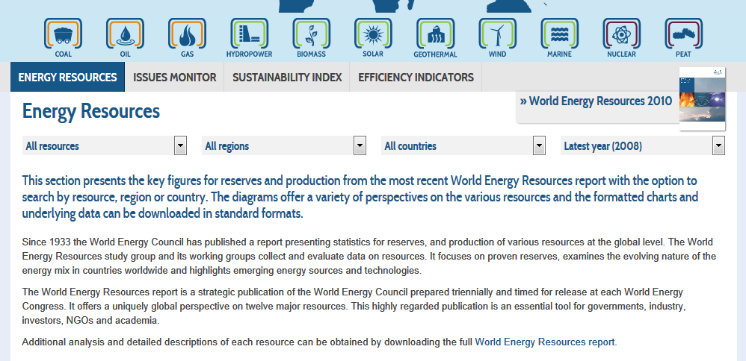
Energy Resources Data

Slide 60
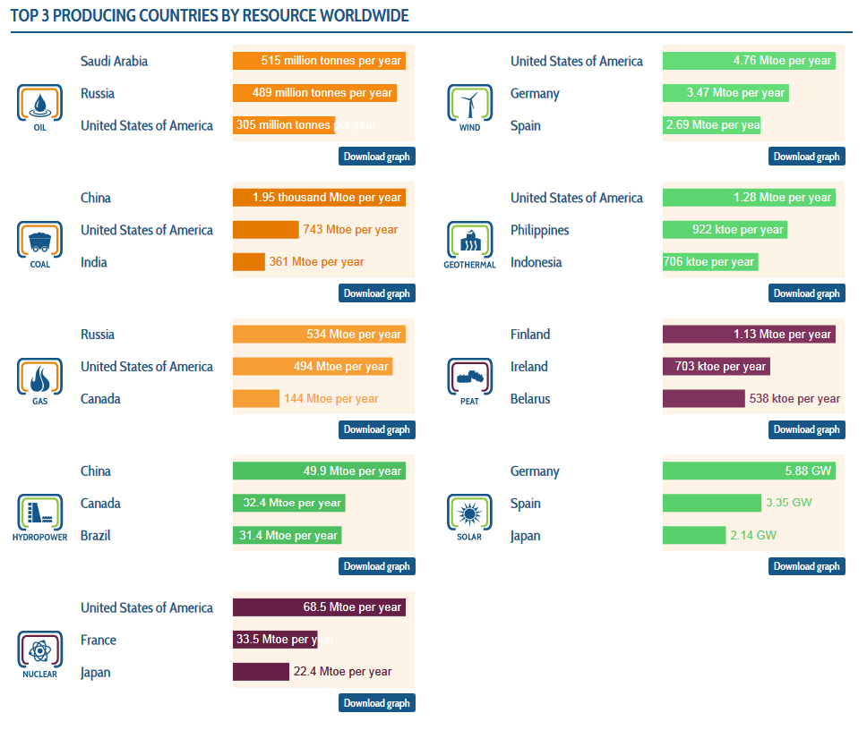
Top 3 producing countries
Notes:
PEAT = tørv

Slide 61
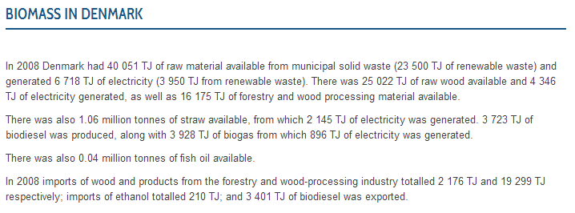
Biomass in Denmark and Sweden

Slide 62
2010 Survey of Energy Resources
World Energy Resources, a survey of global resources and technologies. It identifies what energy resources we have and what technologies are being used to exploit these resources.

Slide 63
Thank you
Leif Sønderberg Petersen
lepe@dtu.dk
worldenergy.org/dk

