Slide 1
Welcome Biorefining from raw material to high value products Örestad, Denmark September 18, 2013

Slide 2
Program:
09.00-10.00 Poster session, coffee and registration
^{10.00 Welcome} Josefin Ahlqvist, Project leader, Biorefinery Oresund
10.15 Summary of the result of the Biorefinery Oresund Program Mahiri Workman, Assoc Prof., DTU Systems Biology
10.45 Enzymatic biomass conversion optimization and sugar production for fuels and chemicals Johan Börjesson, Senior Scientist, Novozymes A/S, Denmark
11.15 Sustainability Assessment of Biorefinery Systems John A. Posada Duque, Dr Copernicus Institute of Sustainable Development - Energy & Resources, Utrecht University
11.45 UK Driving Industrial Biotechnology uptake and the Bio economy – the UK strategy Rebecca Wood, Technology Theme Manager – Industrial Biotechnology, Chemistry Innovation and The Industrial Biotechnology Leadership Forum (IBLF), UK
^{Lunch 12.15 – 13.15}

Slide 3
13.15 Biorefinery: the bridge between Agriculture and Chemistry Marieke Bruins, Dr. Ir. ME Biobased Commodity Chemicals, ^{Wageningen University}
13.45 Global trends and policies in renewable energy Leif Sonderberg Petersen, Secretary General, World Energy Council
14.15 – 15.00 Poster session and coffee break
15.00 Jerusalem artichoke as raw material in the Biorefinery Concept Ingólfur Bragi Gunnarsson, DTU Environment
15.30 Bio Base Europe Pilot Plant- Closing the gap in the ^{innovation chain} Hendrik Waegeman, Ph. D. Business Developer, Bio Base Europe Pilot Plant
16.00 Discussion and concluding remarks Chaired by Bo Mattiasson, Prof. Dept. of Biotechnology, Anneberg Biorefinery Plant
^{16.30 End of session}

Slide 4
An Inter regional program
Start: October 1, 2010
Ends: September 30, 2013
Total budget: 3 070 934 EUR
EU-funding: 1 535 469 EUR

Slide 5
Steering group, seniors
DTU Systems Biology, Mhairi Workman
DTU Environment, Irini Angelidaki and Hans-Christian Holten Lützhøft
DTU Chemistry, John Woodley and Pär Tufvesson
LTH Environment and Energy Studies, Linda Tufvesson
LTH, Dept. Of Biotechnology, Bo Mattiasson
SLU, Alnarp, Eva Johansson

Slide 6
Advisory Board
Perstorp AB, Stefan Lundmark
Kalundborg Municipal, Cluster Biofuels, Niels Larsen
Nordic Sugar AB, Bjarne Fallesen
Federation of Swedish Farmers – LRF, Ewa Marie Rellman
Novozymes A/S, Johan Börjesson

Slide 7
Biorefinery Öresund
Swedish and Danish researchers and participants are collaborating to create contact and
communicate with society, companies, politicians, media and other scientists and students in the Oresund Region
Pilot scale plant
Mobile Units
Process development
Process optimization
LCA studies
Economical studies
Agriculture based with own crops
The Oresund region have very similar crops and tradition in agriculture
A regional, cross country collaboration can guarantee steady supply of raw material
A very interesting match of knowledge in biotech is found in the region
The project is aiming to involve the industries in the region

Slide 8
Media coverage
TT
Skåne får bioraffinaderi | Tidningarnas Telegrambyrå | 22 aug. 2011
PAPPERSMEDIA
Skåne får bioraffinaderi | Linköpings Tidning/Kinda-Posten | Sid 9 | 25 aug. 2011
Snart dags för plast från jordbruket | Process Nordic | Sid 7 | 25 aug. 2011
Oljan ersätts med blast | Kristianstadsbladet | Sid 8-9 | 24 aug. 2011
Restprodukter + bakterier = plast | Ny Teknik | Sid 10 | 24 aug. 2011
Skåne får bioraffinaderi | Nordvästra Skånes Tidningar | Sid 16 | 23 aug. 2011
Skåne får bioraffinaderi | Dagens Nyheter | Sid 29 | 23 aug. 2011
Skåne får bioraffinaderi | Landskrona Posten | Sid 16 | 23 aug. 2011
Skåne får bioraffinaderi | VLT | Sid 10 (del 1) | 23 aug. 2011
Skåne får bioraffinaderi | Dagens Industri | Sid 22 | 23 aug. 2011
Skåne får bioraffinaderi | Helsingborgs Dagblad | Sid 16 | 23 aug. 2011
Plastpåsar utan olja - snart på riktigt i Svalöv | Metro - Skåne | Sid 4 | 23 aug. 2011
Plastpåsar utan olja i Svalöv | Metro - Göteborg | Sid 2 | 23 aug. 2011
Raffinaderi ska göra plast av grödor | Svenska Dagbladet | Sid 19 (del 2) | 23 aug. 2011
Forskning: Skånskt bioraffinaderi utmanar världens oljeberoende - Oljan ska ersättas med blast | Sydsvenskan | Sid 6 (del 1) | 22 aug. 2011
Svampar är motorn i biofabriken | Sydsvenskan | Sid 7 (del 1) | 22 aug. 2011

Slide 9
WEBBMEDIA
Från jordärts-kocka till plast | Lokaltidningen Lund | http://ret.nu/eMk59Vdq | 25 aug. 2011
Oljan ersätts med blast | Kristianstadbladet | http://ret.nu/qmq8pCPR | 24 aug. 2011
Grödor blir plast och bränsle i nytt Raffinaderi | Skånska Dagbladet | http://ret.nu/YYgqsVzE | 23 aug. 2011
Bioraffinaderi byggs i Skåne | Chemicalnet | http://ret.nu/WJg819AM | 23 aug. 2011
Skånska grödor blir bioplast | Ny teknik | http://ret.nu/jWrRM2X | 23 aug. 2011
Bioraffinaderi byggs i Skåne | Jordbruksaktuellt | http://ret.nu/hES4cHmk | 22 aug. 2011
Snart dags för plast från jordbruket | Chemicalnet | http://ret.nu/SXh5OJ98 | 22 aug. 2011
Nu kommer Sveriges första bioplast | Miljöaktuellt | http://ret.nu/EZfJyGmc | 22 aug. 2011
Svalöv får bioraffinaderi | Helsingborgs Dagblad | http://ret.nu/OGBAkD8z | 22 aug. 2011
Oljan ska ersättas med blast | Sydsvenskan | http://ret.nu/IbppuZWS | 22 aug. 2011
Nytt bioraffinaderi baseras på åkerbruk | Green Industry | http://www.greenindustry.se/2011/08/nytt-bioraffinaderi-baseras-pa-jordbruk/ | 23 aug. 2011
And much more..
Swedish television
Vetenskapens Värld
TV 4
SVT
Kunskapskanalen
Swedish and Dansish radio
-and more on the net to come

Slide 10
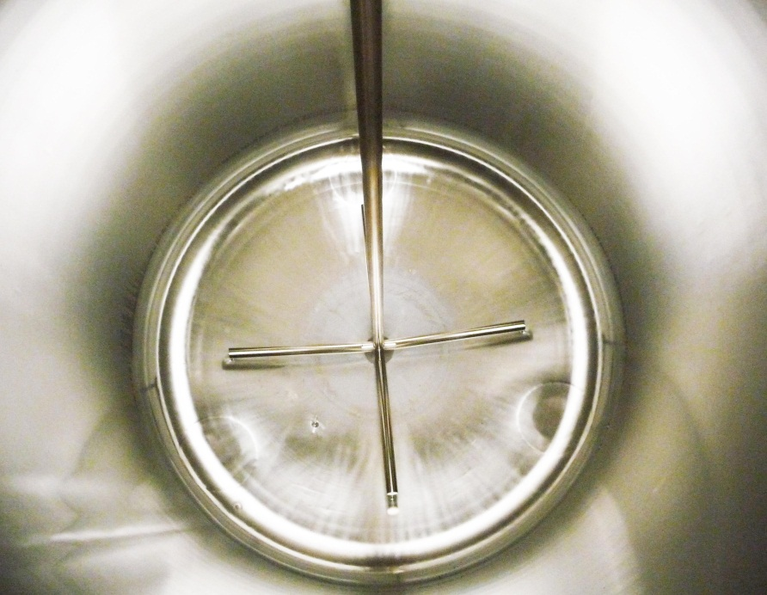
Let´s go!

