Slide 1
Jerusalem artichoke as raw material in the biorefinery concept
Ingólfur Bragi Gunnarsson
Ph.D. student
Supervisor: Prof. Irini Angelidaki
Co-supervisor: Dimitar Karakashev

Slide 2
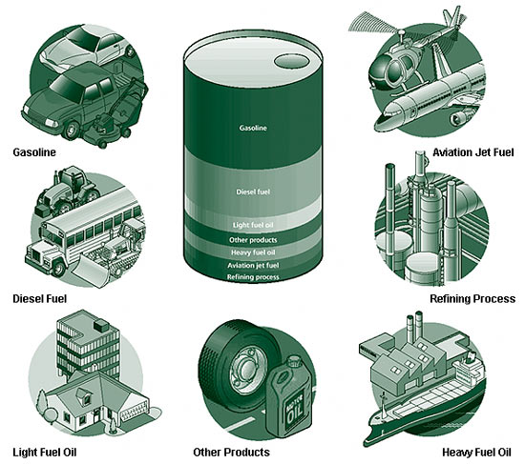
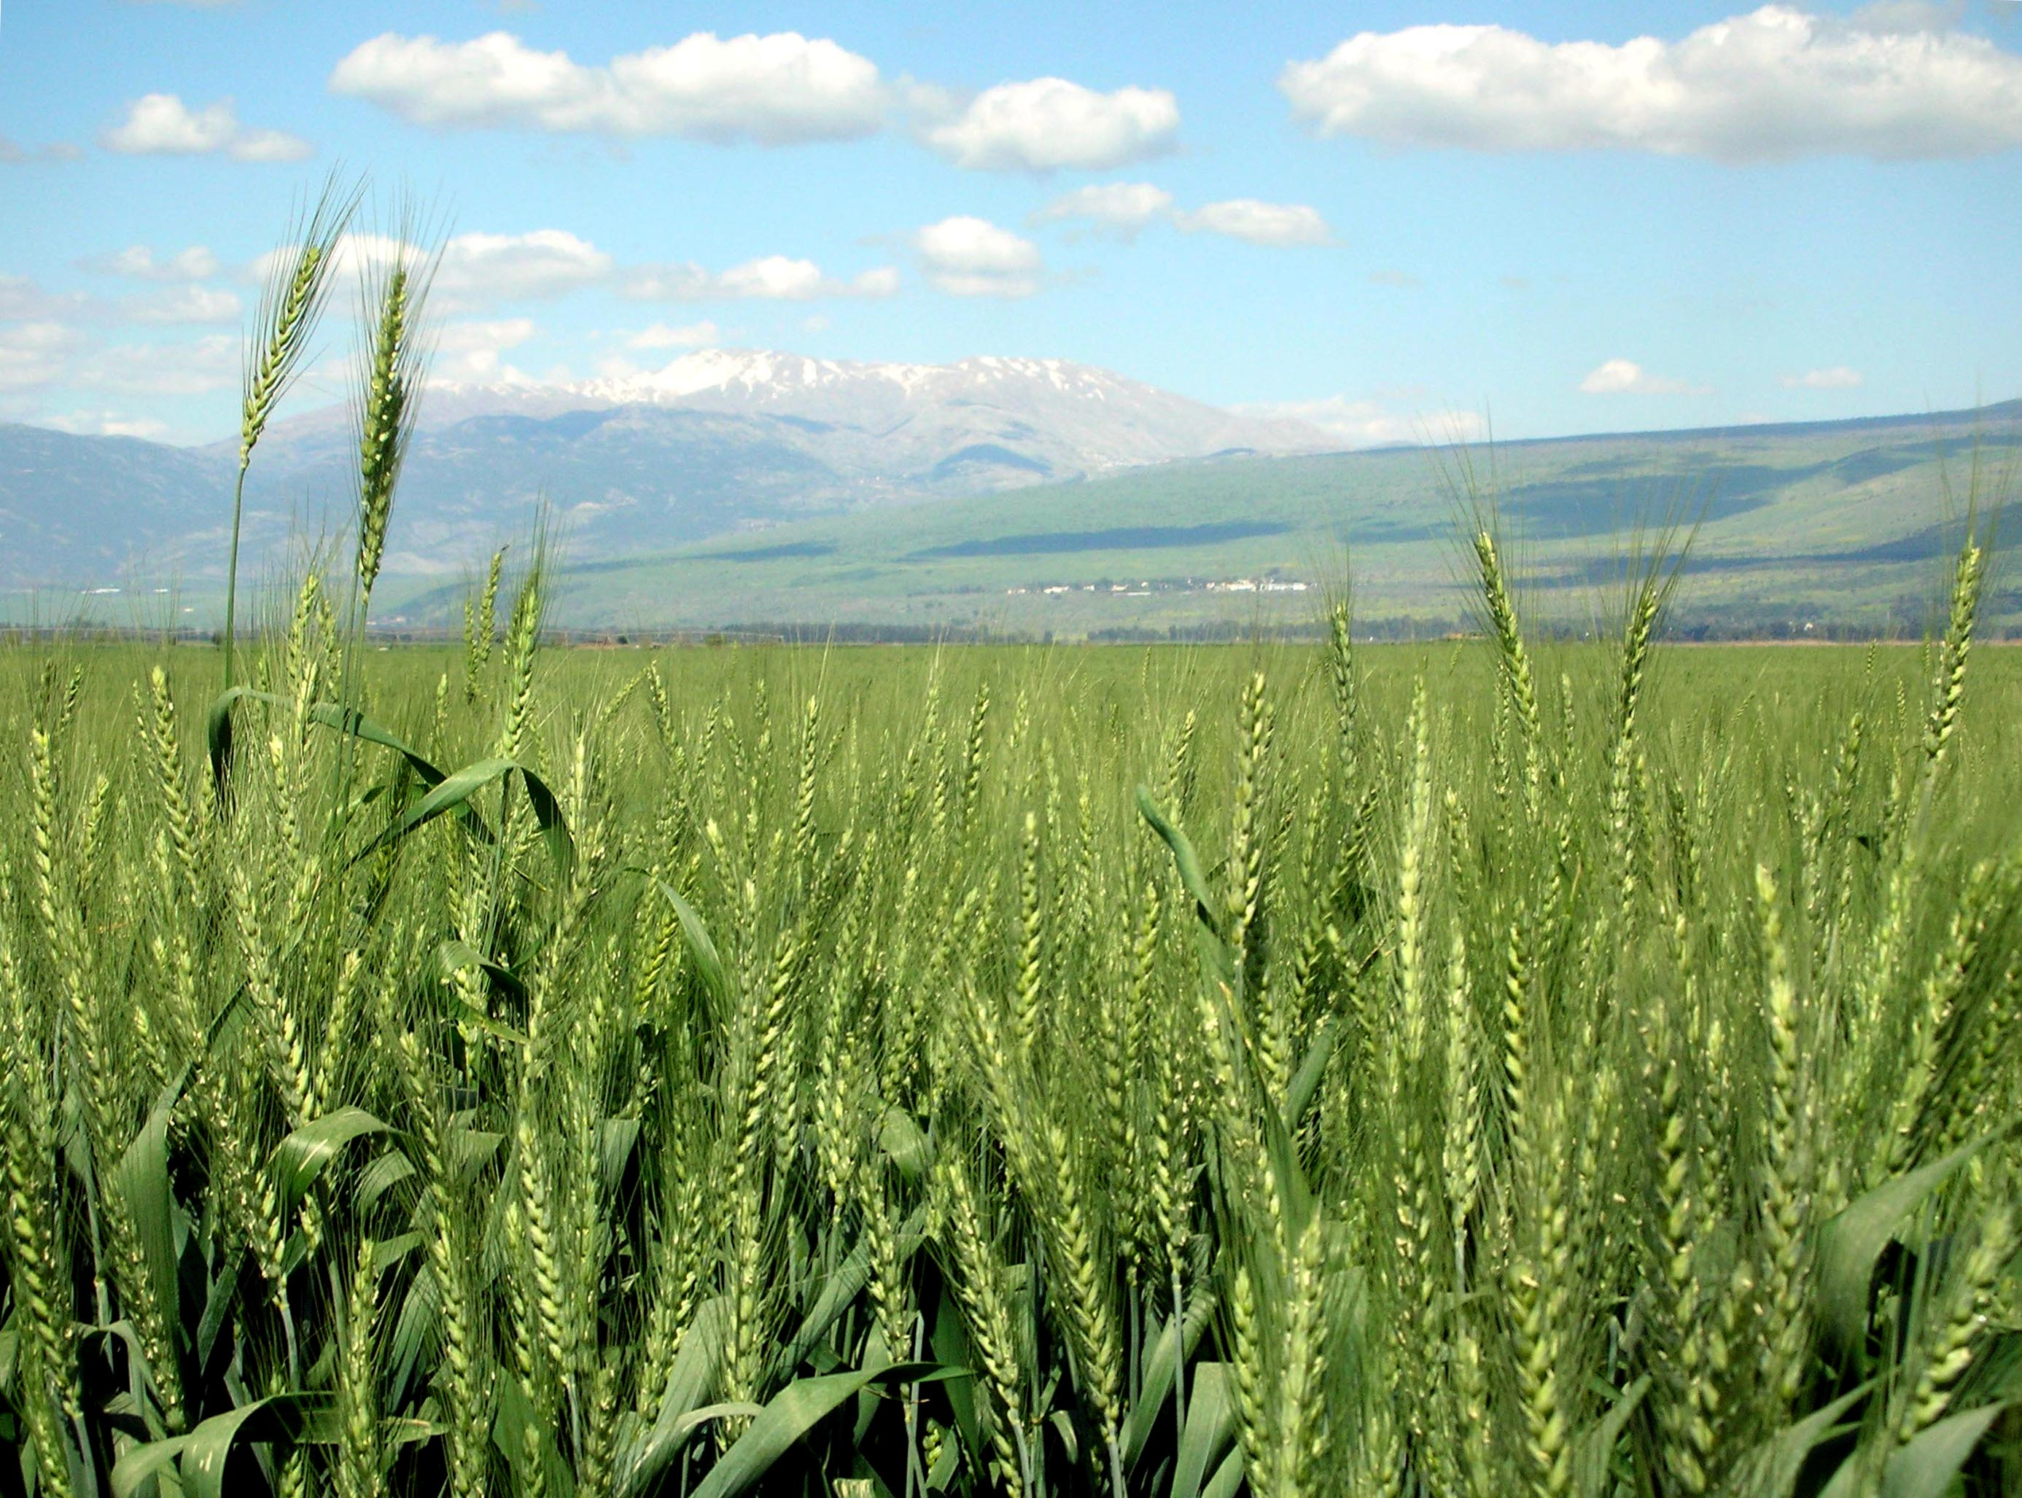
The Biorefinery concept:
Is similar to today’s petroleum refineries
Instead of using petroleum, the numerous refinery products are produced from BIOMASS
A biorefinery should produce a number of products
e.g. biofuels, biochemicals, feed or other products
Production of high-added-value product/s
Otherwise the process becomes uneconomical

Slide 3
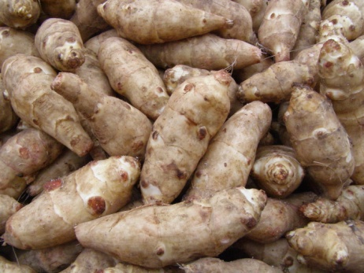
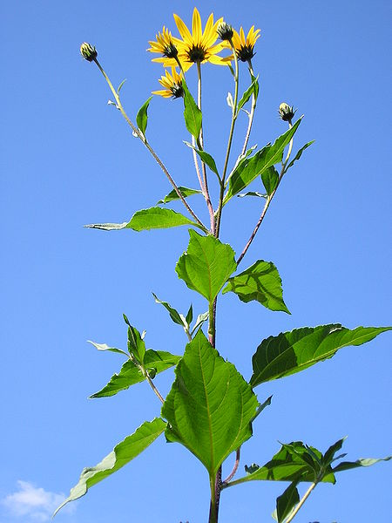
Biomass Jerusalem artichoke
High biomass production yields
Low maintenance crop
Frost and drought tolerant

Slide 4
But....
When to harvest?
Where are the valuable compounds?

Slide 5
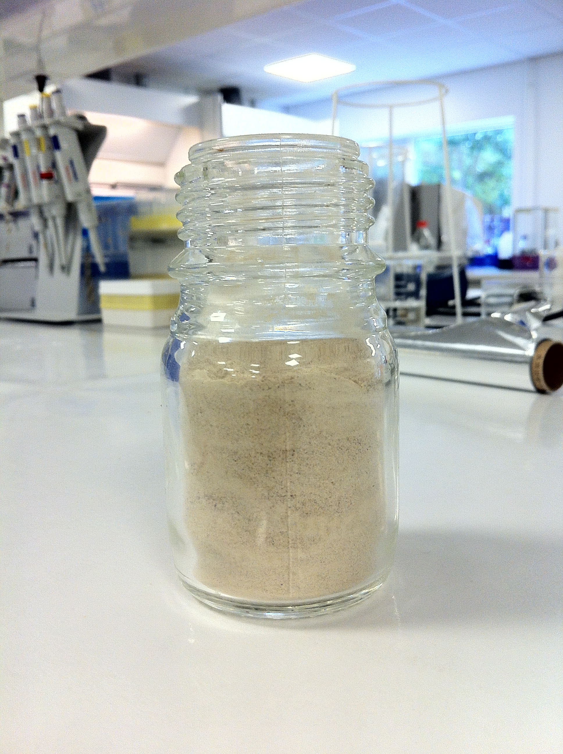
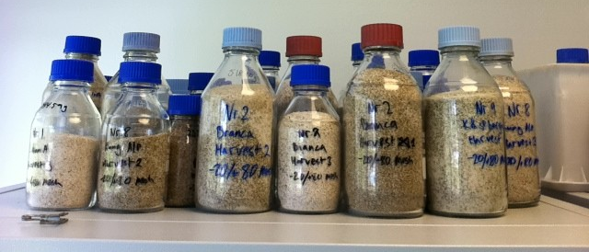
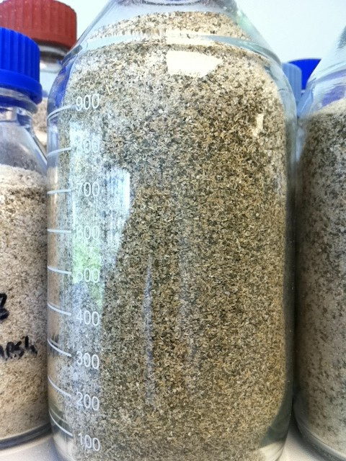
Our biomass
11 different clones
3 harvesting occasions
Lignocellulosic- and tuber fractions

Slide 6
Lignocellulosic biomass

Slide 7
Tuber biomass

Slide 8
Biomass yields
Most lignocellulosic biomass in first harvest
Highest amount DW biomass in last harvest!
Not enough to only look at mass (water content matters).
Most tuber biomass in last harvest
Inulin had highest degree of polymerization at first harvest
High cellulose production yields (Mg/ha)

Slide 9
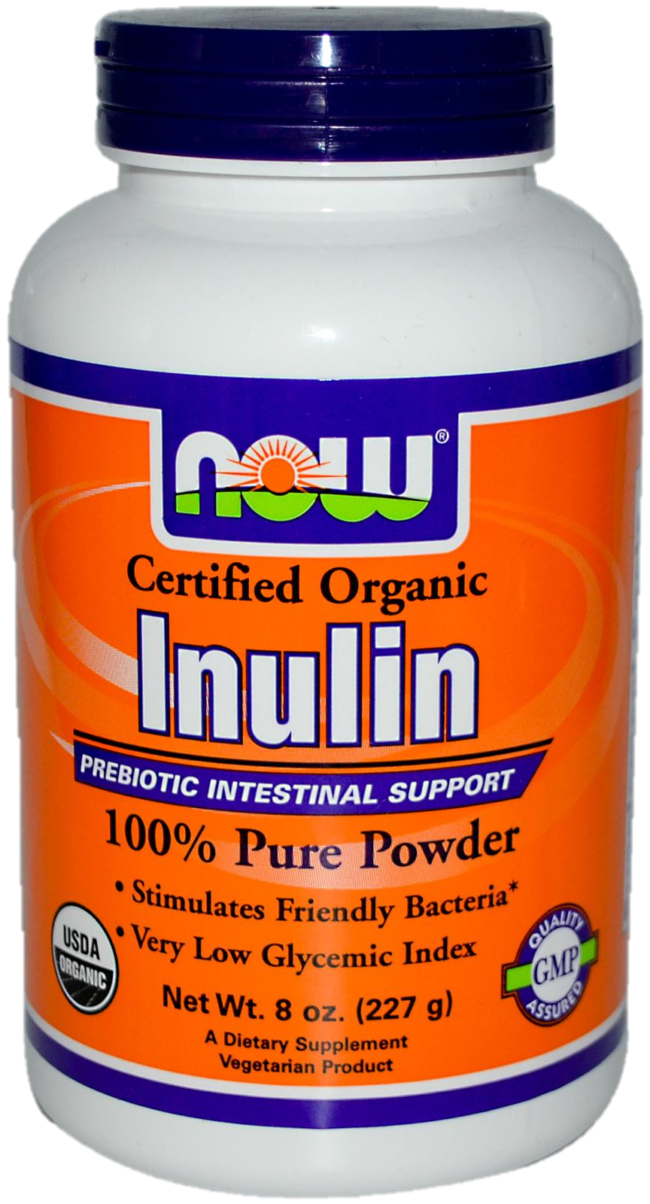
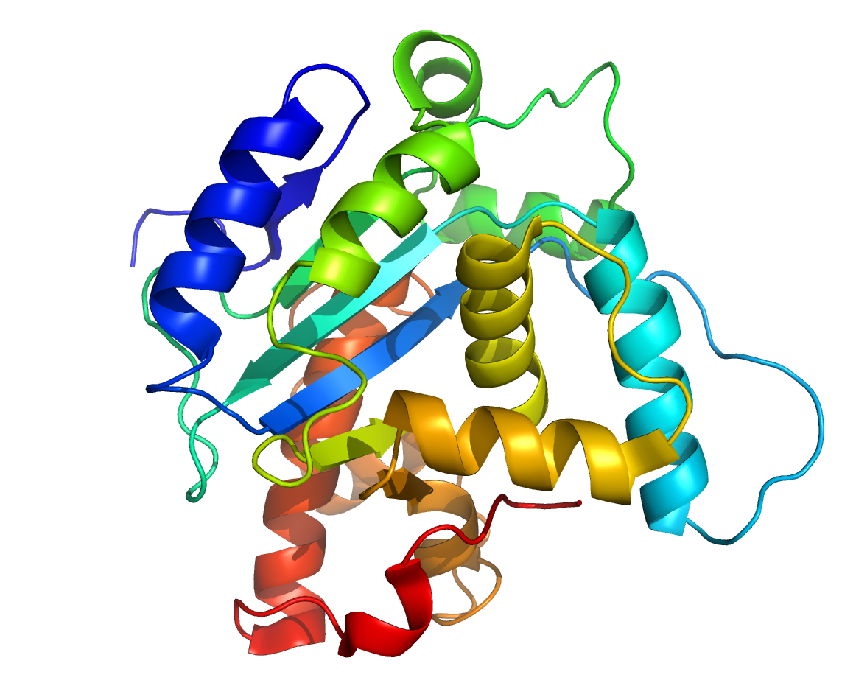
Products so far…
Inulin (high or low degree of polymerization)
Depends on harvesting occasion
Different applications
Protein as high as 10% of DW in tubers
What else?

Slide 10
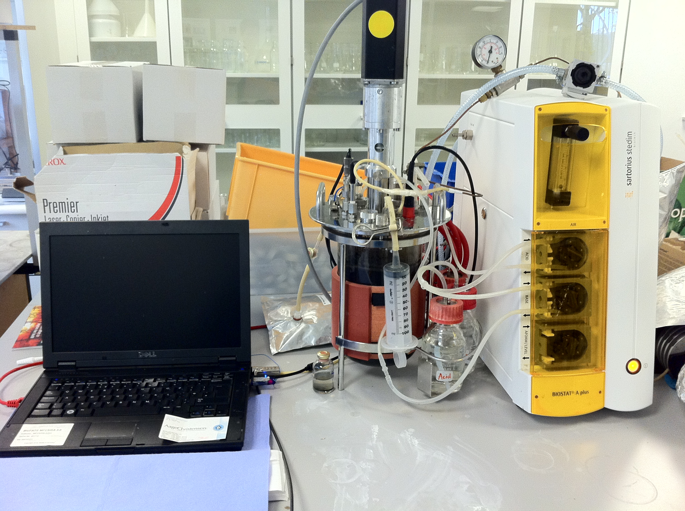
Conversion
Bioethanol (CH₃CH₂OH + CO₂)
Biogas (CH₄ + CO₂)
Produced from waste streams
Autogas (Pure methane)
Biogas upgrading (expensive)
Biosuccinic acid
What is that?
Why?
How?
Notes:
Figure for biogas upgrading!
Biogas: wide spread application, waste used to produce biogas.
Biogas contains methane and co2. however for use in other applicaiton (autogas) we need to remove co2.
Other processes exist but they are expensive and only capture it (not environmentally friendly). Many cases co2 and some ch4 ends up being released into athmosphere.

Slide 11
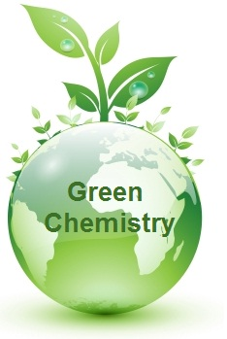
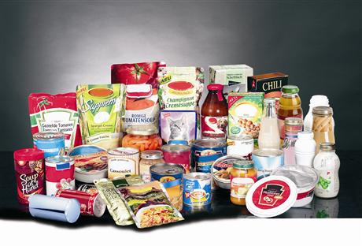
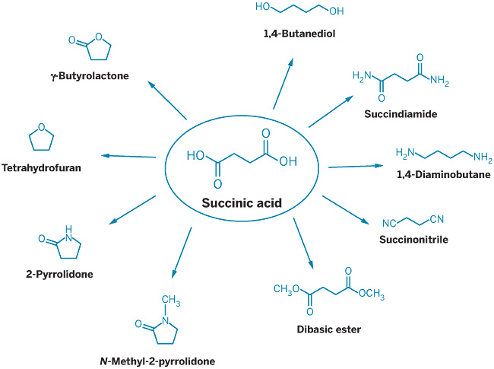
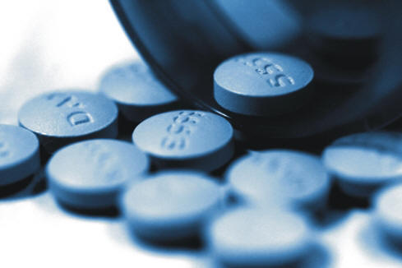
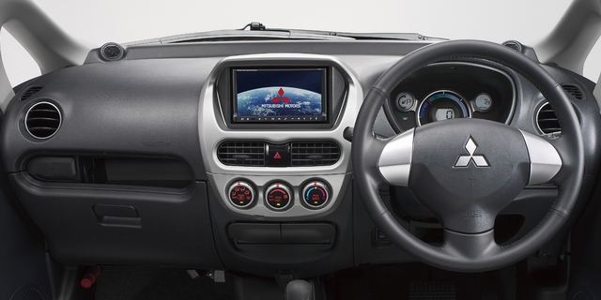
Succinic acid
Currently produced from petrochemicals!
Applications for SA include:
Pharmaceuticals, coatings, biopolymers,resins and solvents.

Slide 12
Biosuccinic acid production
Succinic acid producing bacteria
Actinobacillus succinogenes
Anaerobiospirillum succinoproducens
Mannheimia succiniciproducens
recombinant Escherichia coli strains
recombinant Corynebacterium glutamicum
A. Succinogenes 130Z
Ordered from DSMZ
Fixates CO2 during fermentation
Can utilize a variety of substrates under anaerobic conditions
High tolerance to substrate
High succinic acid tolerance

Slide 13
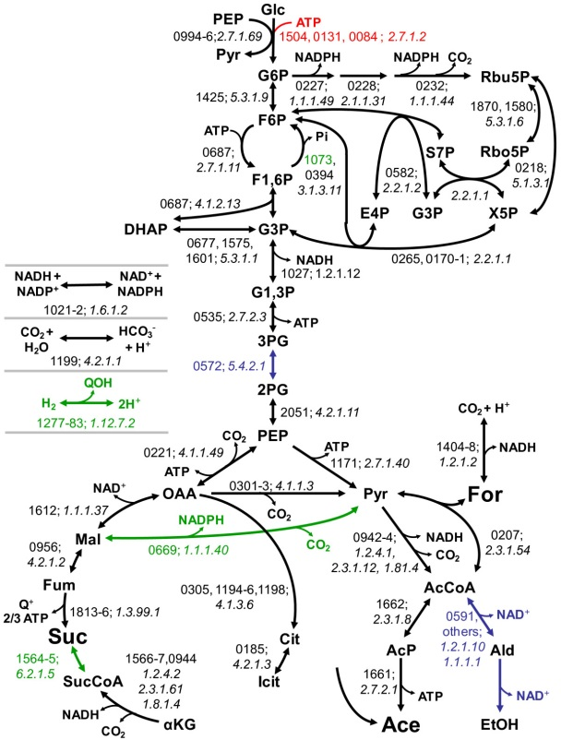

Slide 15
Patented technology
CH₄
Feedstock
Effluent containing Succinic acid
SA bacterium
Biogas (CH₄/CO₂)
Fermenter

Slide 16
Simultaneous biogas upgrading and succinic acid production

Slide 17
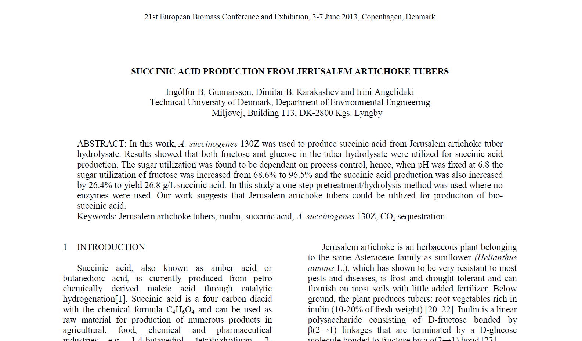
Fermentation of tuber hydrolysates:
SA yield was 80.2% in bottles compared to 77.9% in 3-L bioreactor.
However the SA production was increased by 26.4% in 3-L bioreactor and the D-fructose utilization increased from 68.5% to 96.5%.

Slide 18
Summary
Composition analysis
Harvest occasion very important
Difference between clones not significant
Reduction in CO₂ emissions
Simultaneous biogas upgrading and succinic acid production
The potential is definitely there!

Slide 19
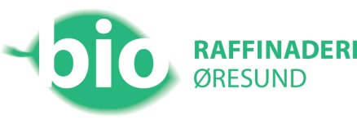
Thank you!

