Slide 1
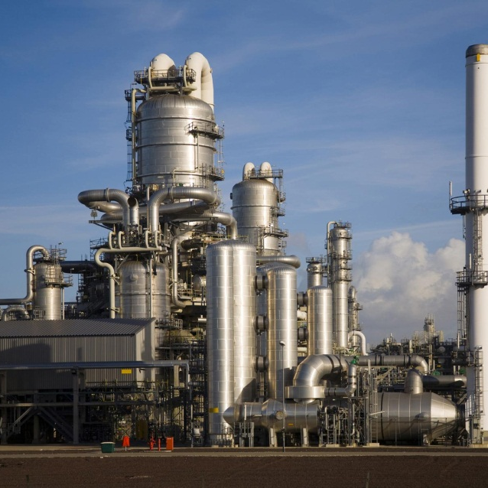


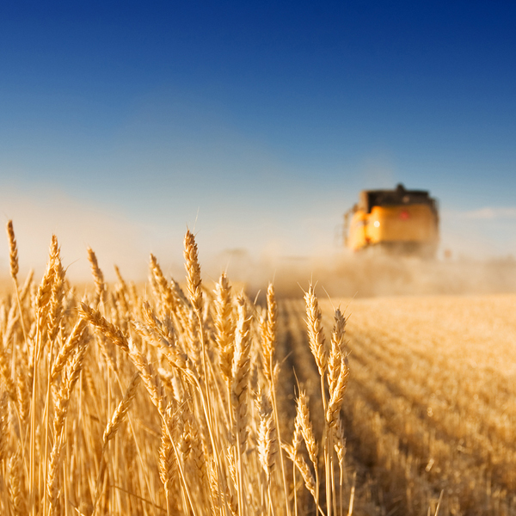
Biorefinery, the bridge between agriculture and chemistry
Marieke Bruins, 18-9-2013

Slide 2
Biomass use today and in 2050
  Mton
Food incl. feed* 5000
Wood, paper, cotton 2000
Wood for cooking 4000
30% of 1000EJ in 2050= 20 000
All bulk chemicals in 2050 600(= 2000 input!)
* Excluding grass and seafood
Only increasing field yields will not satisfy demands

Slide 3
How to make better use of biomass under sustainable conditions?
Biorefinery as a tool
  Four rules for good biorefinery
  Examples
Small scale as a special case

Slide 4

Biorefinery
Biorefining: Sustainable processing of biomass into a spectrum of bio-based products (food, feed, chemicals, materials) and bioenergy (biofuels, power and/or heat).

Slide 5
How to compete with fossil under sustainable conditions?
  Choose the right raw material
  Use all biomass components
  Use each component at its highest value:
  (molecular) structure is much better than caloric value
  However, keep components on the field that are required for soil fertility

Slide 6
How to compete with fossil under sustainable conditions?
  Choose the right raw material
  Use all biomass components
  Use each component at its highest value:
  (molecular) structure is much better than caloric value
  However, keep components on the field that are required for soil fertility

Slide 7
Raw material
Sugarcane, corn for sugar, starch based biorefinery: Often better used as food
The alternative: Lignocellulosic feedstock: development of pre-treatment methods needed

Slide 8
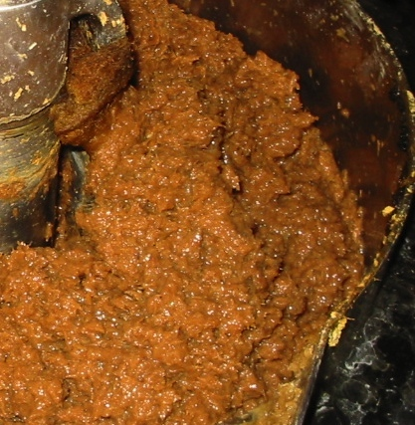
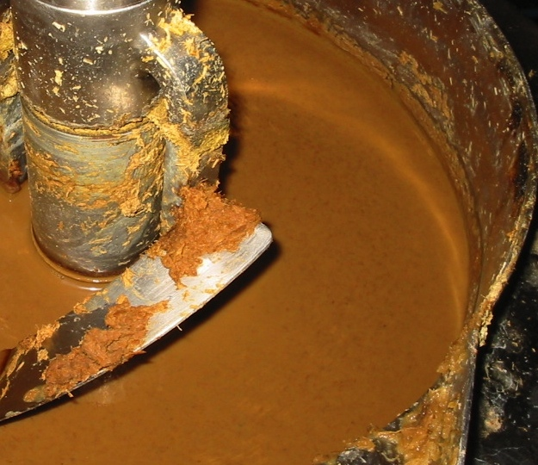
Lignocellulose hydrolysate, not an ideal substrate yet
Mixing problems, low oxygen transfer, low substrate concentrations, fermentation inhibitors
Complex: implications for product recovery

Slide 9
Why do aerobic fermentations have low Y_{s}
Lysine: 0.45 g/g
Glutamic acid: 0.48 g/g
While anaerobic fermentations have high yields
Lactate: 0.95 g/g
Ethanol: 0.95 J/J

Slide 10
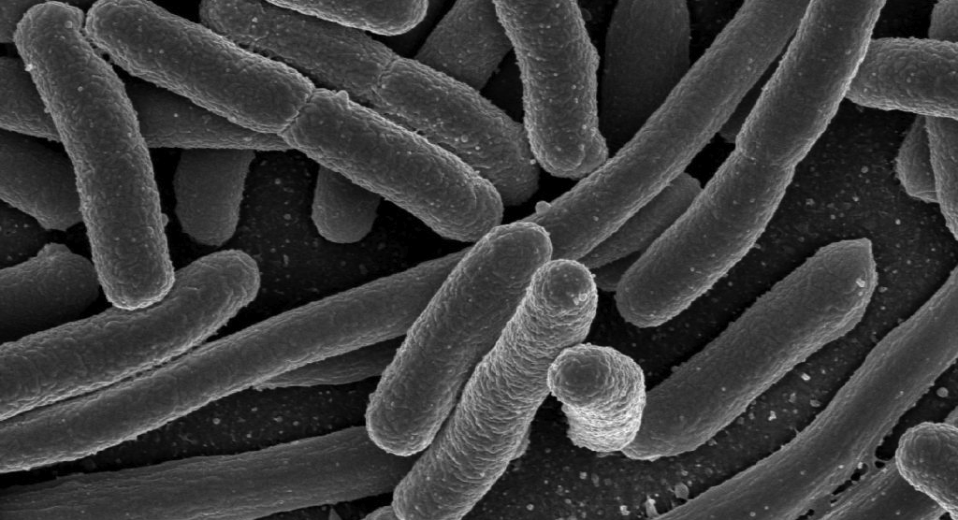
Anaerobic fermentations
 |  | Aerobic |  | Anaerobic
Productivity | ✗ | Limited by O₂ transfer | ✔ | No O₂ required
 | ✗ | Limited by cooling capacity | ✔ | Low heat production
Substrate efficiency | ✗ | High biomass production | ✔ | Low biomass production
 | ✗ | Complete oxidation of substrate to CO₂ | ✔ | No complete oxidation

Slide 11
Anaerobic fermentations
Productivity: up to 5 times higher as compared to aerobic
Less cooling equipment
No compressor
Much less stirring
Leading to much lower capital costs per ton of product

Slide 12
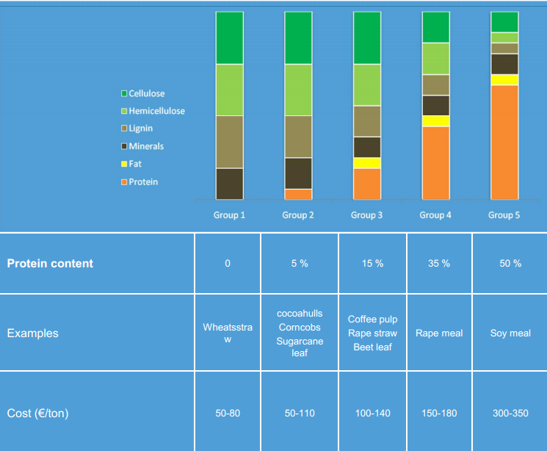
Green Biorefinery
Teekens et al. (in preparation)

Slide 13
How to compete with fossil under sustainable conditions?
  Choose the right raw material
  Use all biomass components
  Use each component at its highest value:
  (molecular) structure is much better than caloric value
  However, keep components on the field that are required for soil fertility

Slide 14
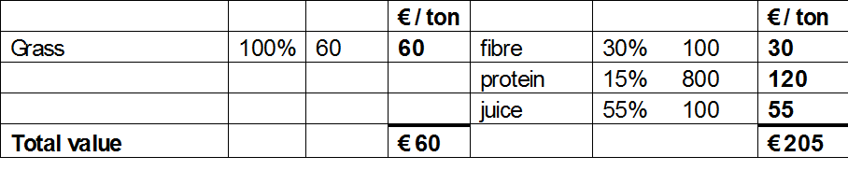
Grass: few products or many ?

Slide 15
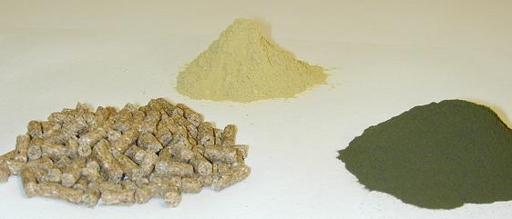
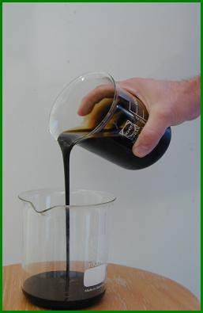
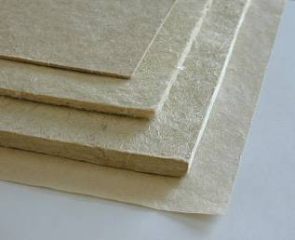
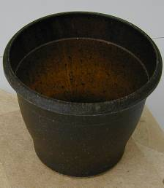
Grass Biorefinery
CULTURE
CUTTING
TRANSPORT
PRESERVATION
STORAGE
REFINING
patent pending
JUICE FRACTION
SEPARATION
FIBER FRACTION
Grass protein (products)
white grass protein
PROTEIN RECOVERY
DRYING
green grass protein
EVAPORATION
FRACTIONATION
Grass juice concentrate
compound feed
Fibre (products)
DOWN STREAM
PROCESSING
2°-generation products

Slide 16
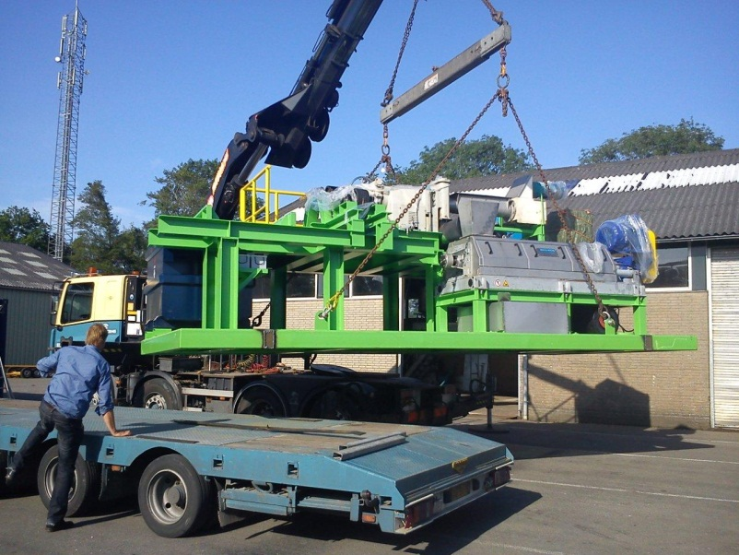
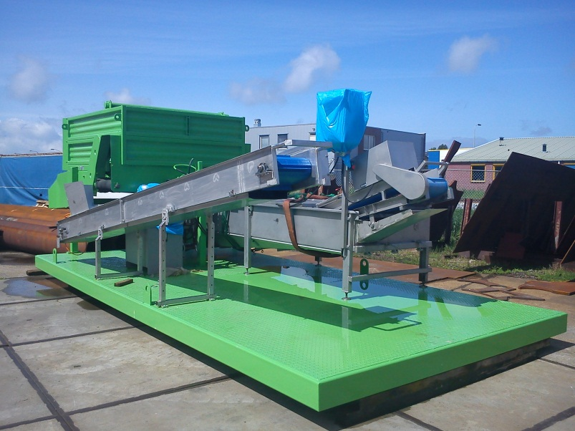
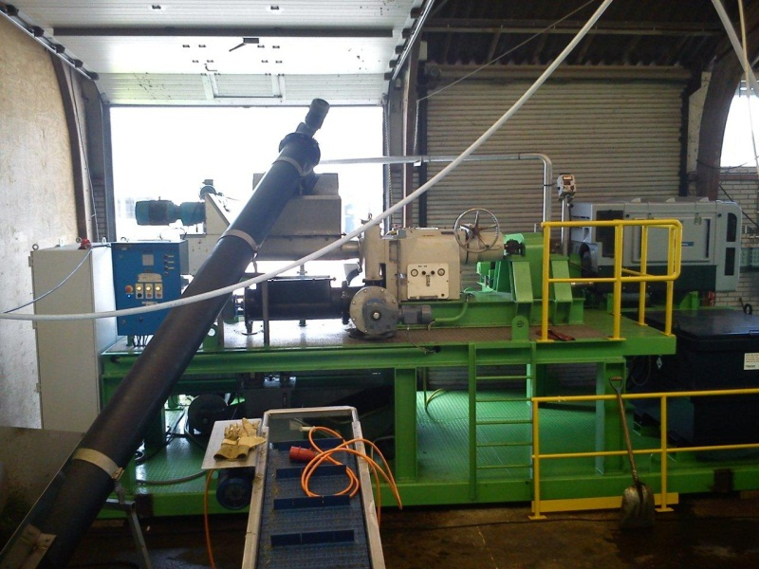
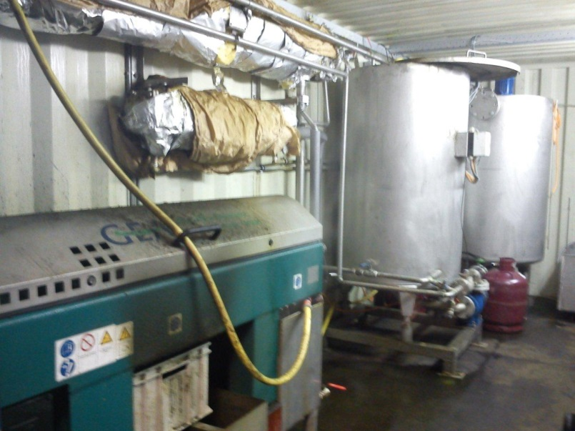
Grass Biorefinery
Mobile pilot GRASSA! Oenkerk (2011)

Slide 17
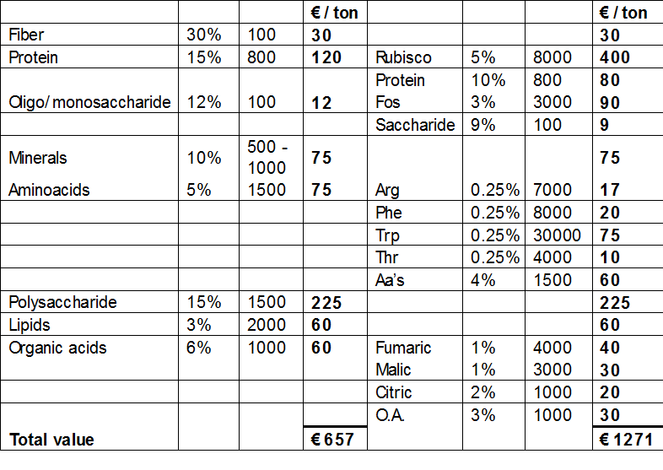
Grass: few products or many ?

Slide 18
Biorefinery enables power generation at 45€/ton and high quality 2nd generation fermentation raw materials for 200€/ ton
Protein
Animal
feed
Amino
acids
Ferment.
substrates
Ligno-
cellulose
Fibres
Phosphorus
Rest
3
Wood
chips
Straw
(field)
Straw
(collected)
Straw
(washed)
Rape
meal
Multiproduct
biorefinery

Slide 19
How to compete with fossil under sustainable conditions?
  Choose the right raw material
  Use all biomass components
  Use each component at its highest value:
  (molecular) structure is much better than caloric value
  However, keep components on the field that are required for soil fertility

Slide 20
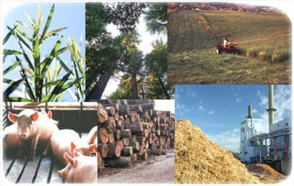
Protein recovery from biomass
Biorefinery is not just producing biofuels
For economic feasibility
protein recovery and use
is an essential part of
the overall biorefinery
Research
  Several biomass sources, preferably “waste”
  Protein hydrolysis to amino acids
  Selective recovery through e.g. crystallization or electrodialysis
  Always in a bigger picture: with the other components

Slide 21

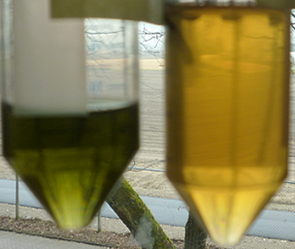
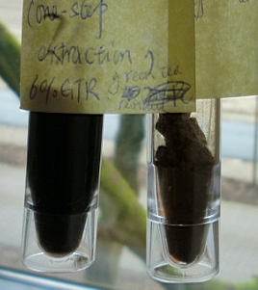
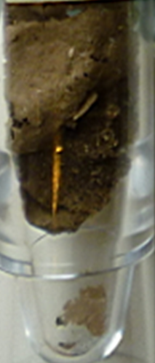
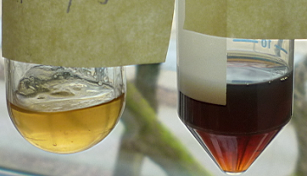

Protein from Tea residue
Also other components
General mechanisms for leaves
Multiple-extraction for multiple products:
One-step extraction for LP
Raw material
Pigment
Polyphenol
Extract
Powder
(freezing dry)
Pectin
Protein
Final residue

Slide 22

Integrated conversion and separation
CEM
-
-
-
-
-
AEM
+
+
+
+
+
CEM
-
-
-
-
-
AEM
+
+
+
+
+
+
Anode
-
Cathode

Slide 23


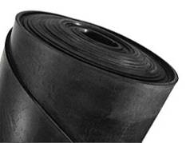



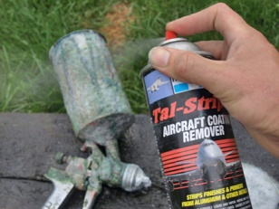
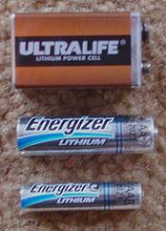
Use of plant molecular structures
N-Vinylpyrrolidone
Acrylonitrile
Glutamic acid
N-Methylpyrrolidone
Diaminobutane

Slide 24
The route to NMP, new vs conventional
New route
step 1
step 2
Glutamic acid
NMP
Conventional route
Amino acids contain N and O.
→ Less steps (= factories) & energy for the same product!

Slide 25
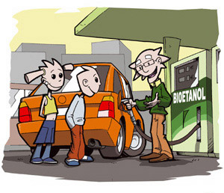
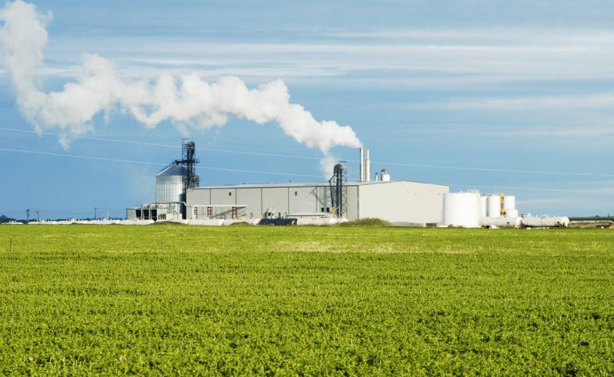
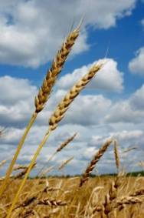
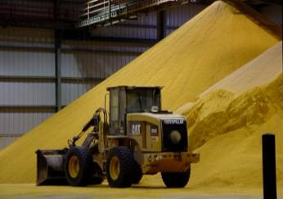
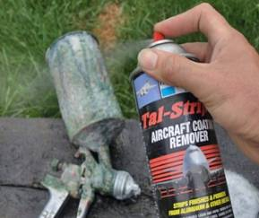
Biobased NMP, makes an ethanol plant profitable
500 Million liters bioethanol
(~ 400 kton) =200M€
360 kton DDGS (~130 € / ton) =46M€
36 kton glutamic acid →
23 kton NMP
(~2500 € / ton)
=58 M€/y

Slide 26
How to compete with fossil under sustainable conditions?
  Choose the right raw material
  Use all biomass components
  Use each component at its highest value:
  (molecular) structure is much better than caloric value
  However, keep components on the field that are required for soil fertility
Do not transport what you do not need

Slide 27
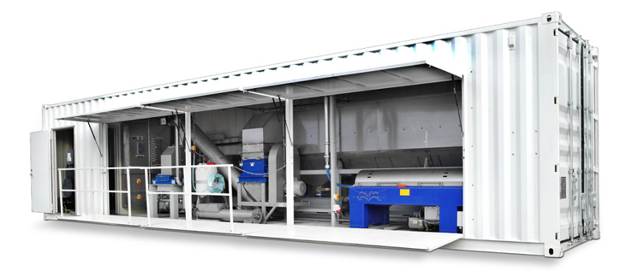
Small scale biorefinery
Solving the problem of low functional density of biomass
Advantages
  Lower transportation costs
  Water and minerals stay on site
  Less waste treatment on (central) factory
  Increased storage times
  More income to farmers
  Faster innovations
Disadvantage
  Economy of scale
Starch from Cassava in Nigeria
Notes:
BioRegional MiniMills UK Ltd broke new ground this month, securing an investment deal that puts the company in a good position to finally commercialise the MiniMill technology, which pulps materials other than wood into paper and recovers energy from the black liquor waste. In the UK up to 20% of imported wood pulp could be replaced by straw, creating a market worth £27m to UK farmers.
Grassa en zeafuels

Slide 28
Advantage: lower transportation cost
Separate before transportation (biomass pre-treatment)

Slide 29
Small scale biorefinery reduces transport cost and seasonality
Fields
Farm
Processing
Present
100%
100%
Return flow 10%
concentration
fermentation
Concept
Small scale processing
100%
30%
Return flow 70%

Slide 30
Advantage: lower transportation cost
Separate before transportation (biomass pre-treatment)
Local biomass and local product
Fuels
  Biogas
  Ethanol
  PPO
  Pellets/pyrolysis

Slide 31


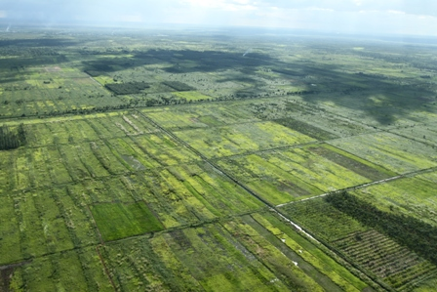

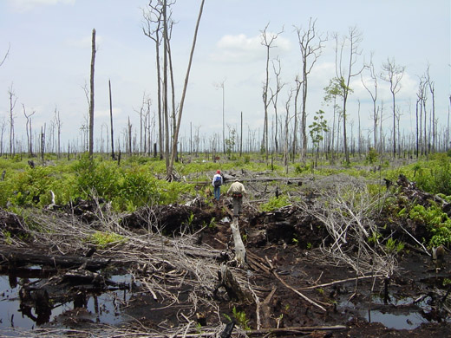
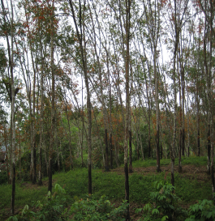
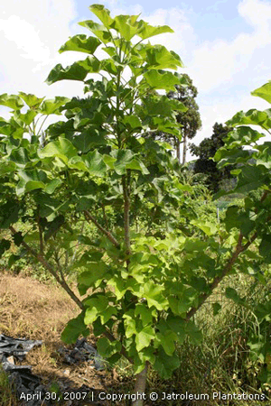
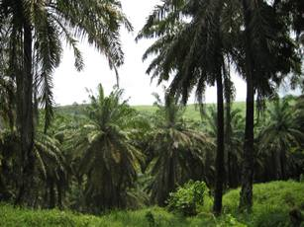

Central Kalimantan
Mega Rice Project (1996-1998)
rubber
Jatropha
oil palm

Slide 32
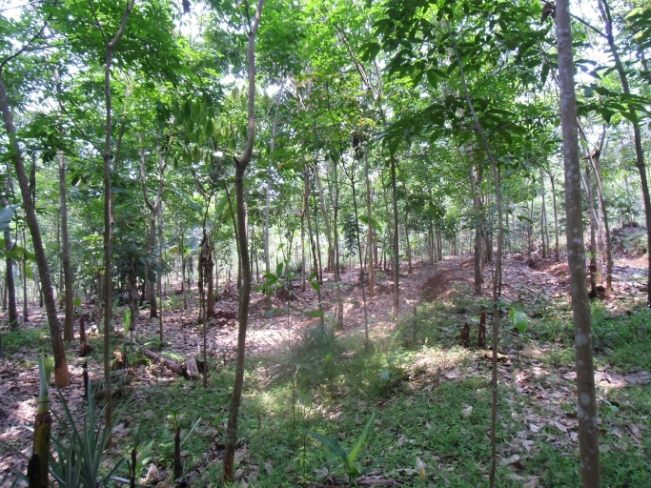
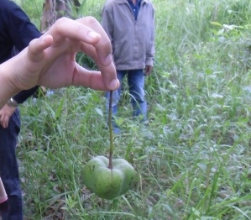
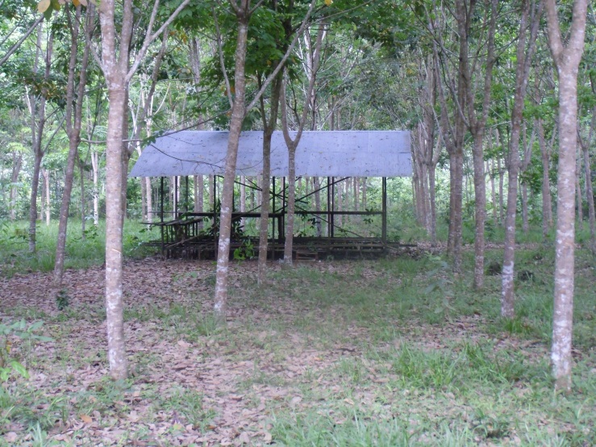
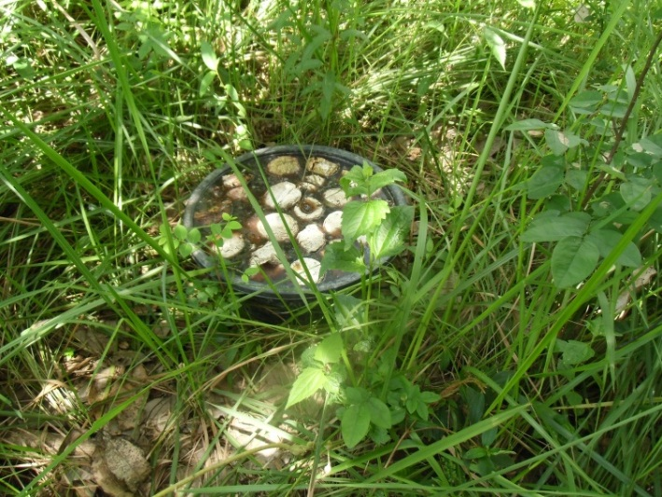
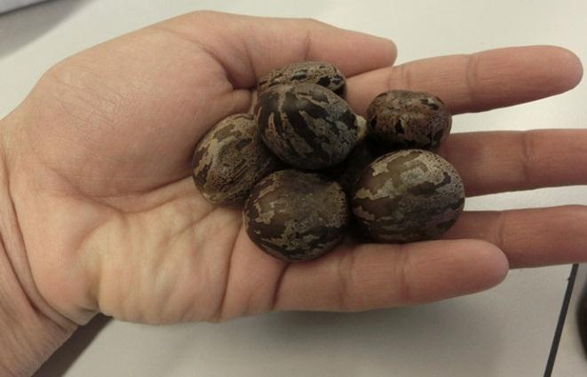
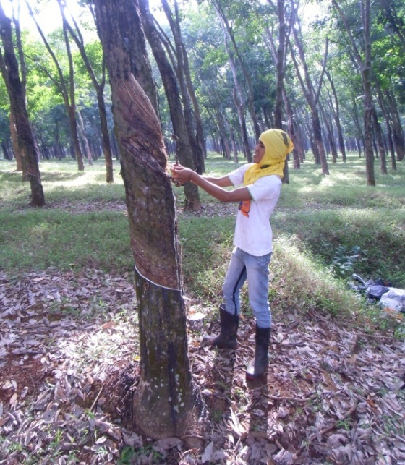
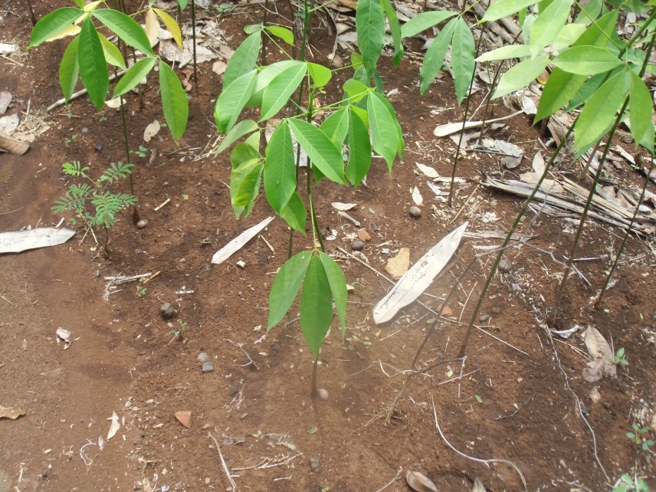
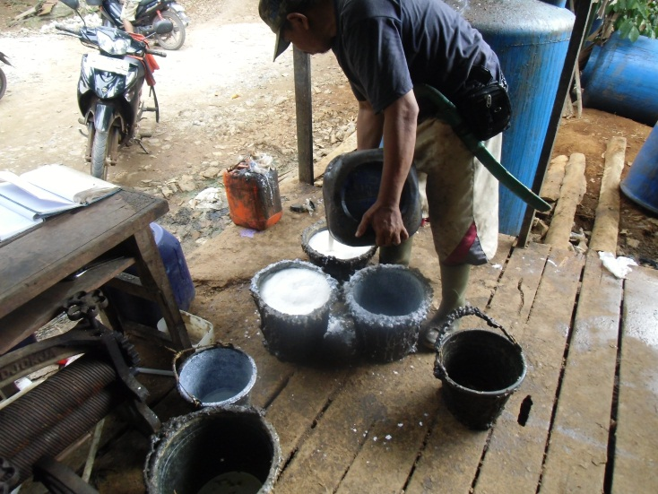
Available
Small farmers
Waste

Slide 33

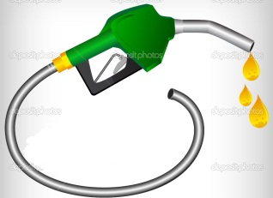
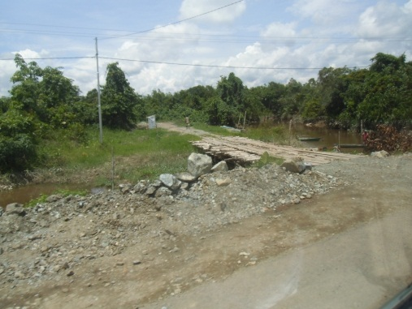
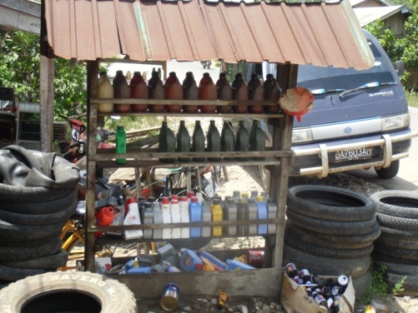
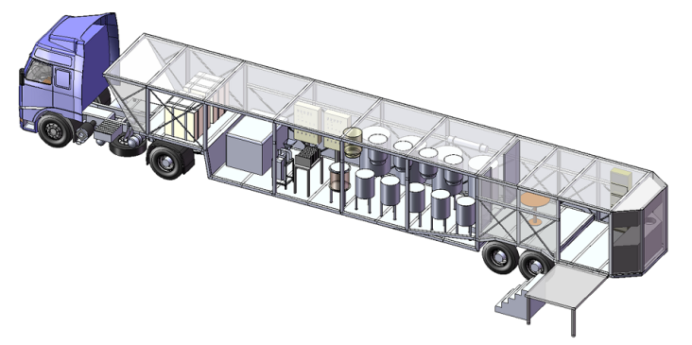
Breakthroughs in biofuels: Mobile technology for biodiesel production from Indonesian resources
(local)
markets

Slide 34

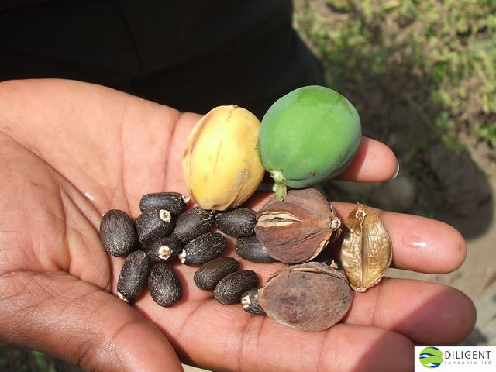
Agriculture beyond food
Two worlds meet:
Mobile biodiesel refining
Protein extraction
Oil Crops
Rubber
Jatropha
Oil palm
Mobile
Seed Processing unit
Biodiesel synthesis and work-up
(local) markets
Protein
Protein work-up

Slide 35
Advantage: water and minerals stay on site

Slide 36
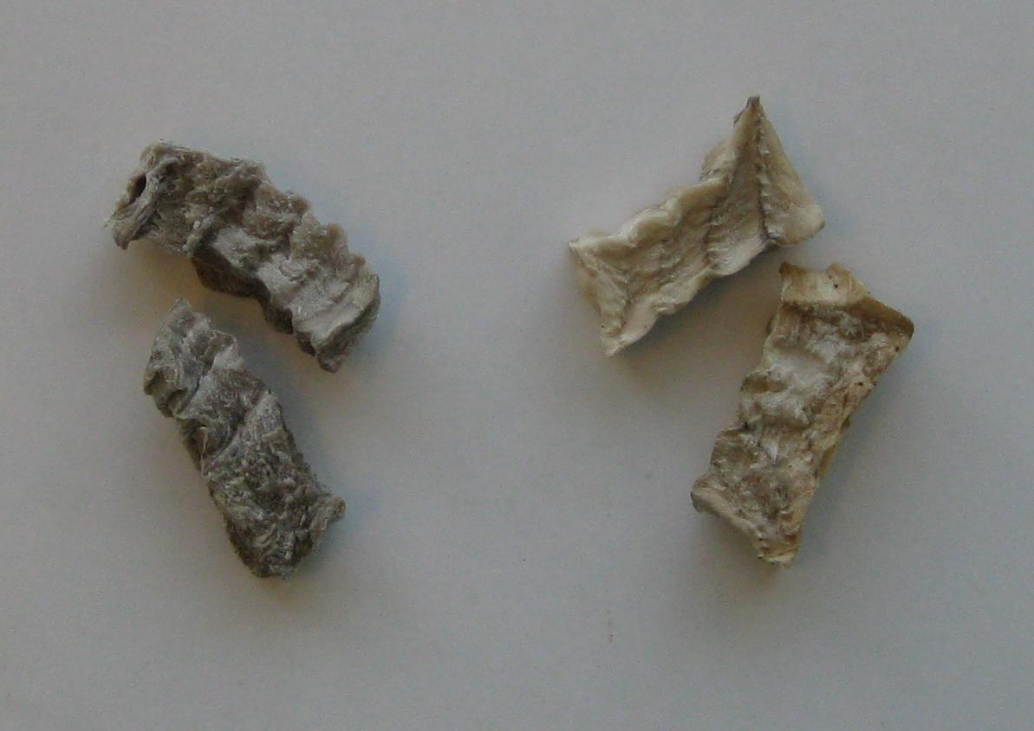
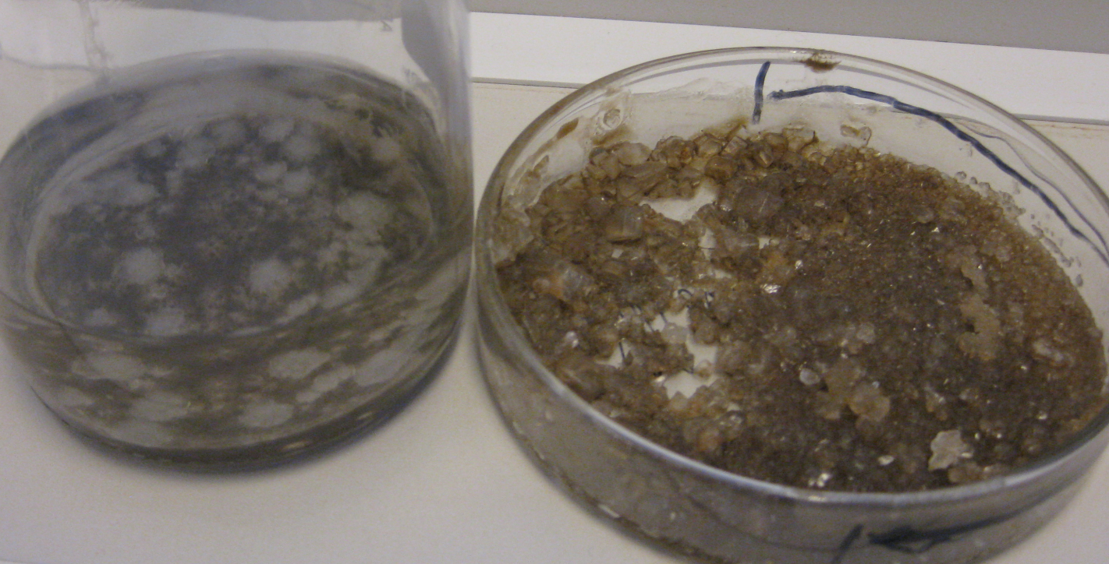
Advantage: water and minerals stay on site
Drying: Transport advantage
Dewatering: Additional advantages
Do not take from the field what you do not need
Another advantage:
less waste treatment

Slide 37


Advantage: increased storage times
WO2005/121183A1

Slide 38

Advantage: increased storage times
Sugar beet processing in the Netherlands
  September-December/January max. 5 months
Kolfschoten et al (in preparation)

Slide 39

Advantage: more income to farmers
Redistribution of income in the chain
More jobs in rural areas
Less dependent on industrial contracts down stream
Incentive to increase productivity
Farmers are entrepreneurs:
  Biogas
  TKI small scale biorefinery
  Important stakeholders

Slide 40

Advantage: faster innovation
“Factory at the size of a pilot plant”
Low absolute CAPEX
Easier to change
Can be improved with subsequent factories

Slide 41
Disadvantage: economy of scale

Slide 42
Design rules for scaling in biorefinery
Advantages of small scale without the disadvantages
Splitting the process in two parts
Low investment cost
Minimize heat exchange
Energy use and the combination with biogas and CHP
Developments start bottom-up
Bruins & Sanders (2012) BioFPR 6(2):135-145
Notes:
There is no water in the petrochemical industry

Slide 43
Biorefinery, the bridge between agriculture and chemistry
  Choose the right raw material
  Use all biomass components
  Use each component at its highest value:
  (molecular) structure is much better than caloric value
  However, keep components on the field that are required for soil fertility

Slide 44
Biorefinery, the bridge between agriculture and chemistry, Biorefining, from raw material to high value products
  Choose the right raw material
  Use all biomass components
  Use each component at its highest value:
  (molecular) structure is much better than caloric value
  However, keep components on the field that are required for soil fertility

