Slide 1
Vector accelerator array in constrained memory bandwidth
Project Proposal
Course Code : EDAN85
Course Teacher : Flavius Gruian
Student : Arun Jeevaraj

Slide 2
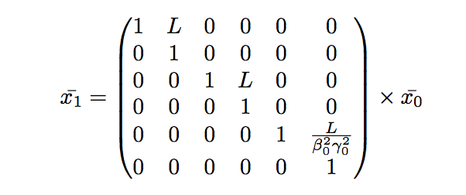
Target Application
Application parameters
L distance
Particle Beam simulator Linear Model with
high density particle space: 10^6 particles
Particles represented by space vector (dimension 6), x, y, z coordinates and momentum parameters
10^6 matrix multiplication per frame.
Drift Space
x0
x1
Drift space
Frame size : 45 MBytes for double precision
Iterative Nature : Test for 1000 frames
Drift space
Drift space
Drift space
Drift space
Frame
Frame
Frame
Frame

Slide 3
Target Hardware Design.
Target Design
Design Requirements
Hardware Design
DDR MEMORY
Maximise throughput
Keep accuracy fidelity
FPGA
Vector Accelerator
Array
Vector Accelerator
Array
RAM
RAM
Use Memory Hierarchy
Use Fixed Point
Vector accelerator Array
RAM

Slide 4
Design Flow
Matlab/Python
Software Simulation Model for reference data (Matlab or python.)
HLS/SystemC behavioral Models.
FPGA Implementation and verification.
Reference Simulation Model
Vivado HLS
Behaviour Simulation Model
Hardware Implementation
Optional :
Use ethernet I/O with PC for testing and verification.

