Slide 1
Snake videogame project proposal
Gani Kumisbek
soc15gku

Slide 2
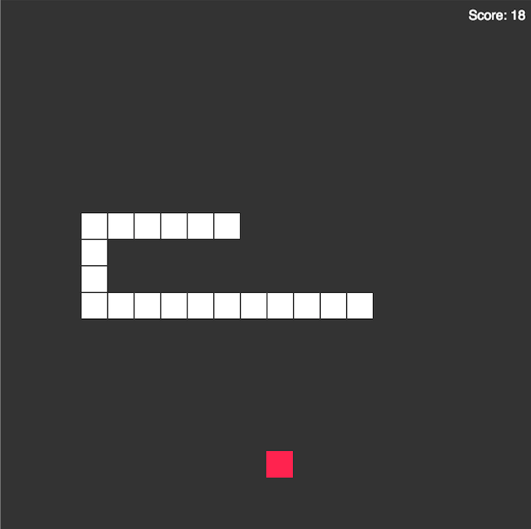
Basic demonstration of the idea

Slide 3
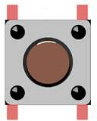
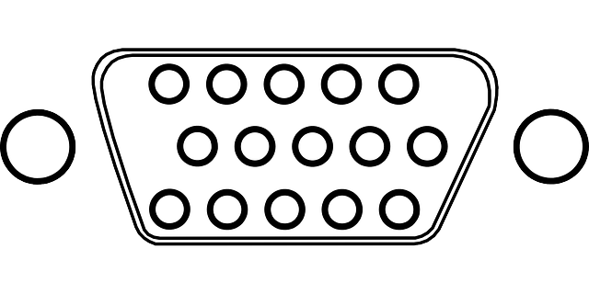
Microblaze CPU
via AXI BUS
BRAM
VGA
controller
Button
controller

Slide 4
Specifications
Screen Resolution: 640 x 480
Refresh Rate: 60 Hz
I/O: 4 Push Buttons
RAM to store sprites and pictures

Slide 5
Time table
WEEK 1 – Project Planning
WEEK 3 – VGA Controller Implementation
WEEK 5 – Software Implementation of the Game Design
WEEK 7 – Debugging
WEEK 8 - Report

Slide 6
GAME OVER

