Slide 1
Push Box
Aohan Jing, soc12aji@student.lu.se
Ying Gao, soc12yga@student.lu.se
Siyuan Fu,soc11fsi@student.lu.se

Slide 2
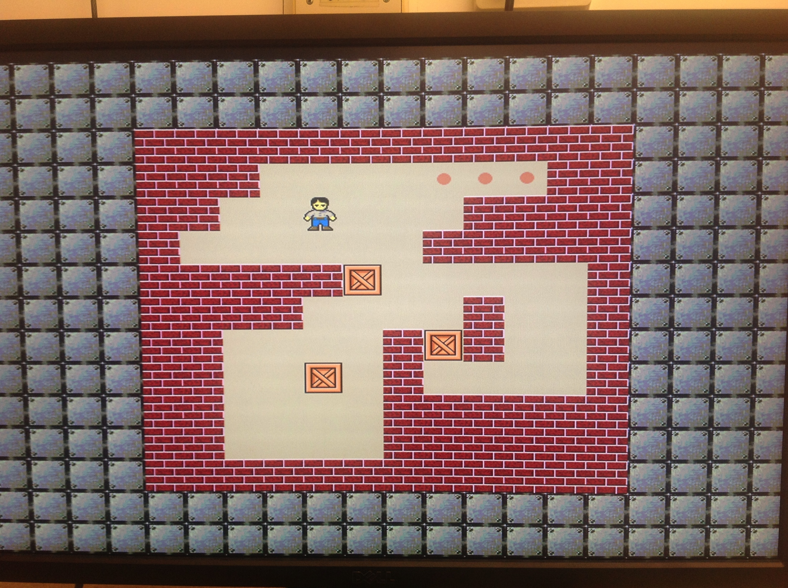
Basic Specification
Push several boxes into several specific spots
First level : easier ground map

Slide 3
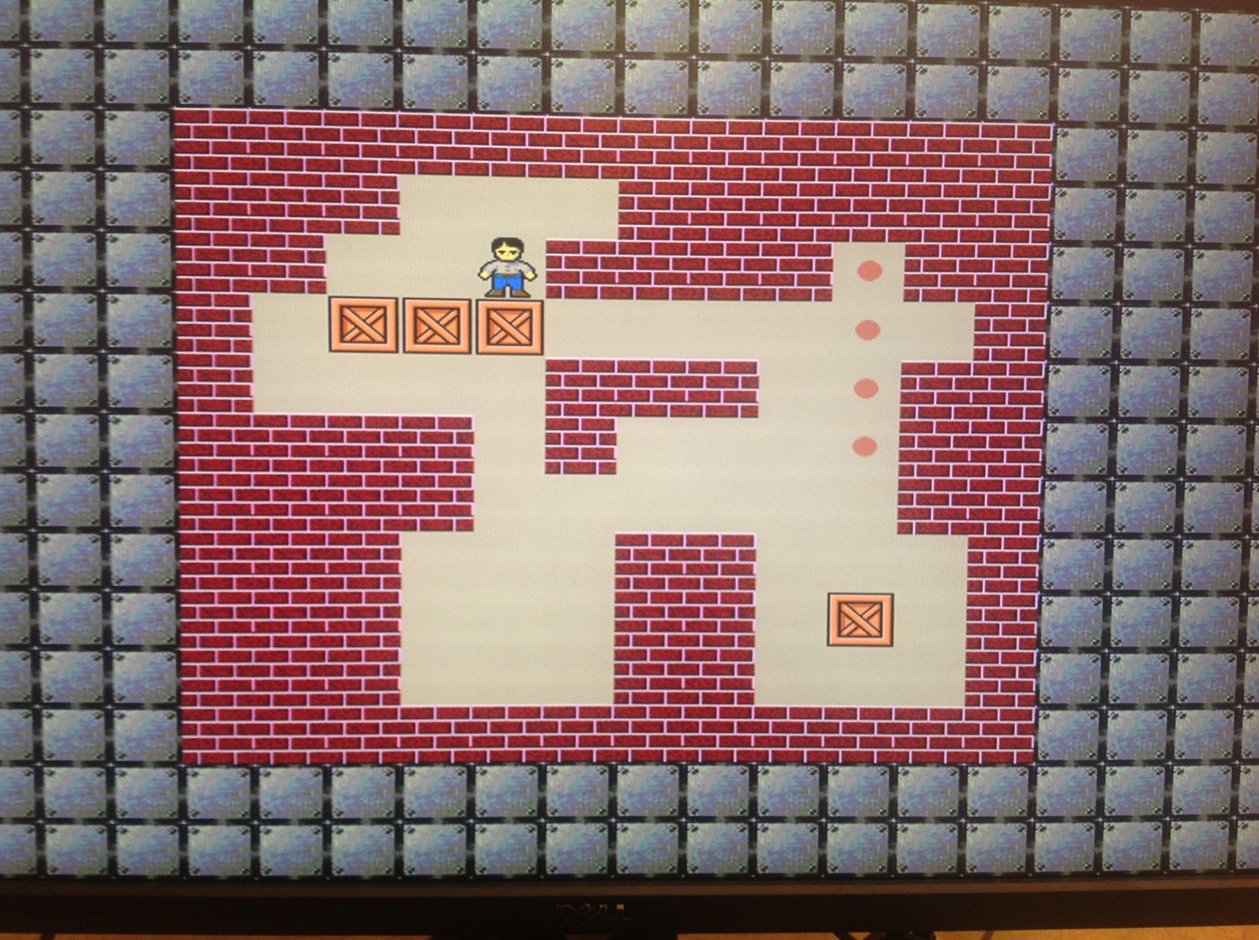
Basic Specification
Second level : complex gound map

Slide 4
Hardware Implementation
The hardware architecture
The position matrix
The figure matrix
The communication protocol
The hardware device occupancy

Slide 5
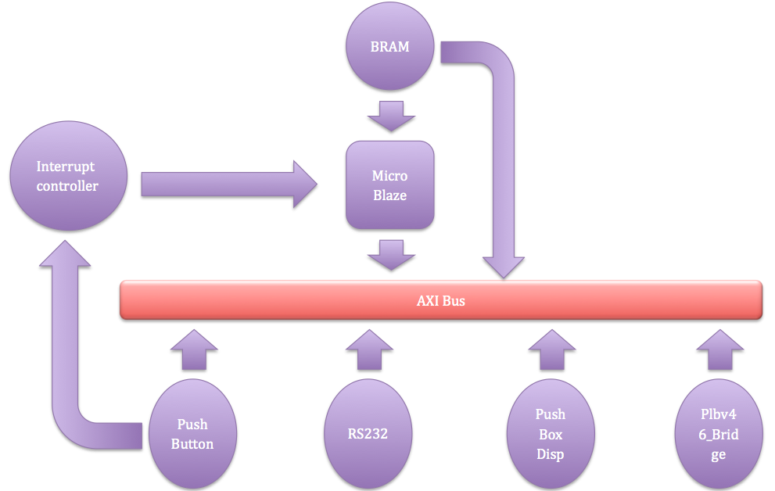
The hardware architecture

Slide 6
The Position Matrix

Slide 7
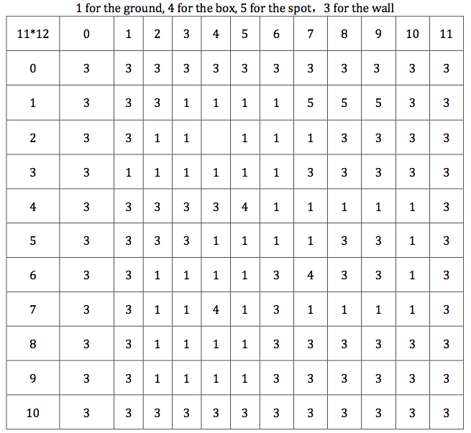
Figure Matrix

Slide 8
Communication Protocol

Slide 9
Hardware Occupancy

Slide 10
Problems & Solutions
SD driver
AXI instead of PLB

Slide 11
Software architecture
1.Initialization
2.GPIO interrupt register
3.Judge win or fail

Slide 12
Initialization
1.Set level

Slide 13
Level 1

Slide 14
Level 2

Slide 15
Level 3

Slide 16
Endless

Slide 17
Initialization
2. Initialize the precise position of the player on the map
3. Initialize the surrounding of the map.
4. According to which level the player is playing, we initialize the different ground map, that is, map_level

Slide 18
GPIO interrupt register
Interrupt response function
Initialize XIntc
Both push button interrupt and interrupt response function connected to Xintc_Connect
Start XIntc
Enable XIntc

Slide 20
Ground Map
1. Foreground map
2. Background map

Slide 21
Judgment of Win
Win condition for one level
Win condition for all levels
Return back to level 1

Slide 23
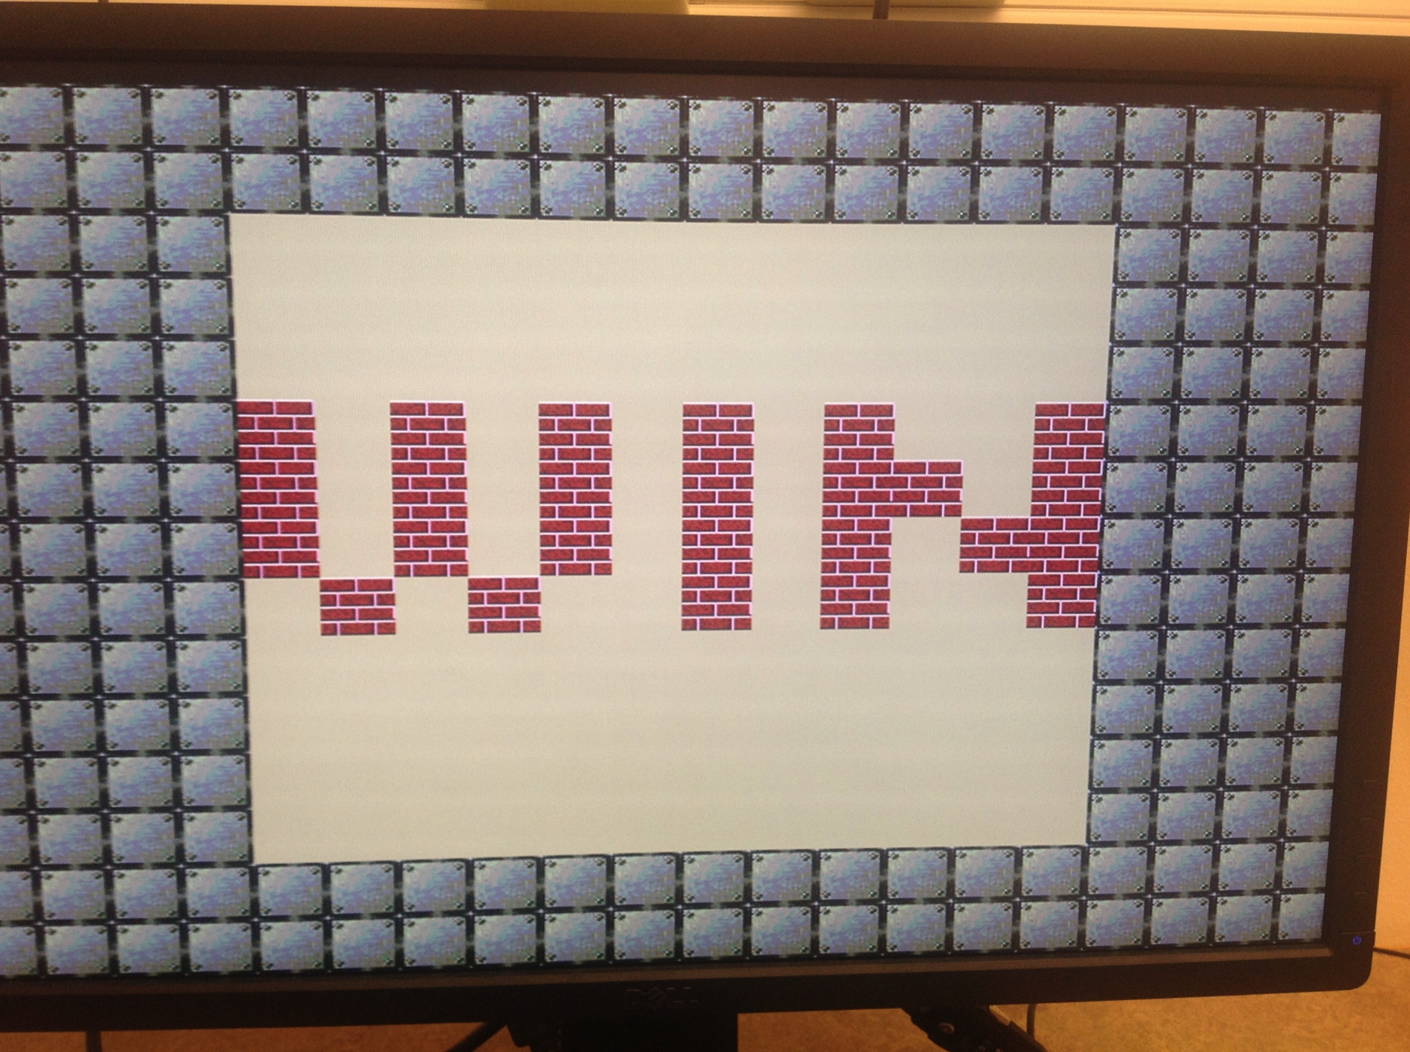
Win

Slide 24
Problem and solution
1.Bram space is not enough
2.PS/2 interrupt can not be registered right

Slide 25
Thank you!

