Slide 1
Hash decoder
By:
Niklas Hjern
Erik Hogeman
Jonas Vistrand

Slide 2
Short description
Hardware accelerated hash decoder.
SHA1 hashed password.
Different types of attacks:
Brute-force.
Dictionary attack.
PS/2 keyboard as input, VGA display as output

Slide 3
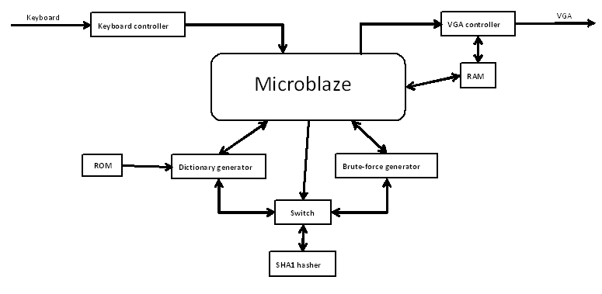
The system

