Slide 1
Bomberman
Fredrik Ahlberg – ael09fah@student.lu.se
Magnus Hultin – ael08mhu@student.lu.se
Adam Johansson – rys08ajo@student.lu.se

Slide 2
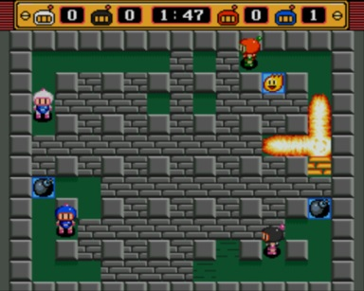
Concept

Slide 3
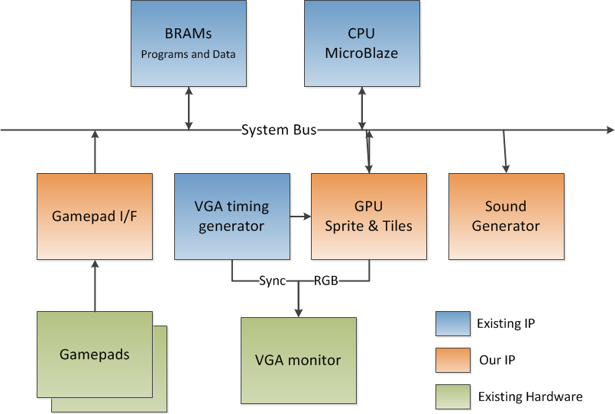
Proposed design

Slide 4
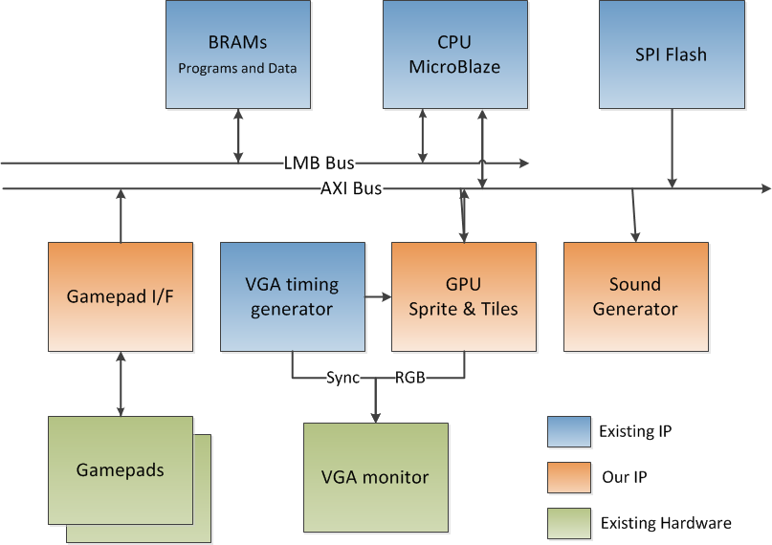
Actual Design

Slide 5
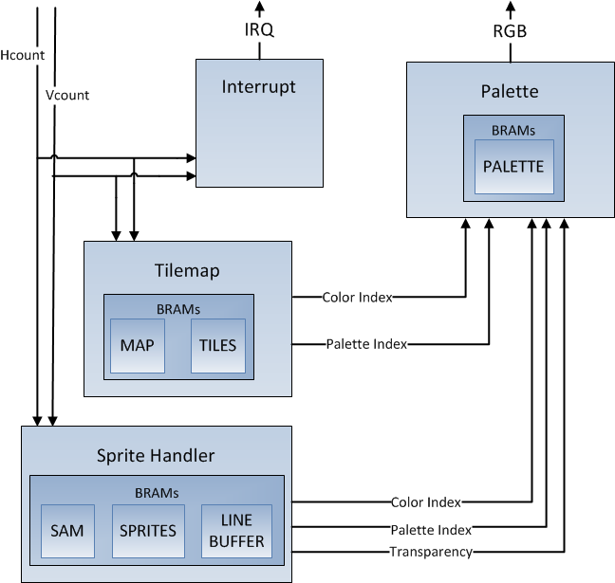
GPU

Slide 6
GPU
Up to 64 16x16px sprite bitmaps
Up to 64 16x16px tile bitmaps
Up to 64 palettes, each containing 16 color combinations
Tilemap is 16x14 tiles, supports scrolling
Sprites and tiles may be flipped
Up to 512 sprites on screen at any time

Slide 7
Gamepad I/F
Real Nintendo 8-bit gamepads
Shift registers in gamepads are polled by hardware and is put into regs.

Slide 8
Sound generator
Takes 8-bit PCM data values (raw audio)
2048 sample ring-buffer
39,1 KHz sample-rate
PWM signal generated @ 391 KHz
Sound data stored in SPI flash
Music and sound effects are mixed in software

Slide 9
Memory Allocation
GPU - 13 BRAMs
MicroBlaze - 16 BRAMs, 32KB
Sound buffer - 1 BRAMs
SPI flash – 9 MB used for music, sound effects, graphics

Slide 10
Software
Game logic is updated during Vblank interrupts @ 60Hz (~1.5 ms window)
Music is mixed and buffered inbetween interrupts
Pseudo-random generator is seeded by gamepad input timing
Total RAM-usage: 27 KB

Slide 11
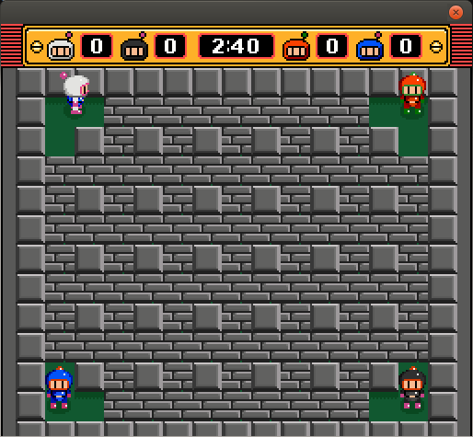
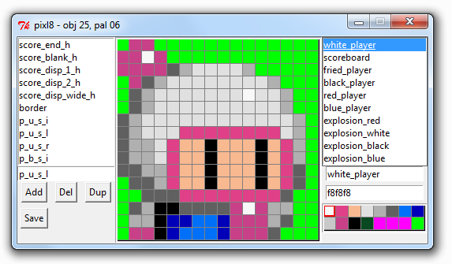
Emulator and Editor
Bitmaps and palettes were generated by us using a custom tool
Emulator was created to test and develop software in parallell with hardware

Slide 12
Conclusion
Fun and rewarding project!
Hard to debug software running on FPGA
Only one computer can use chipscope!?
Challenge to parallellize workload, but…
Used 2 development boards
Used Git for version control
Emulator for software testing

Slide 13
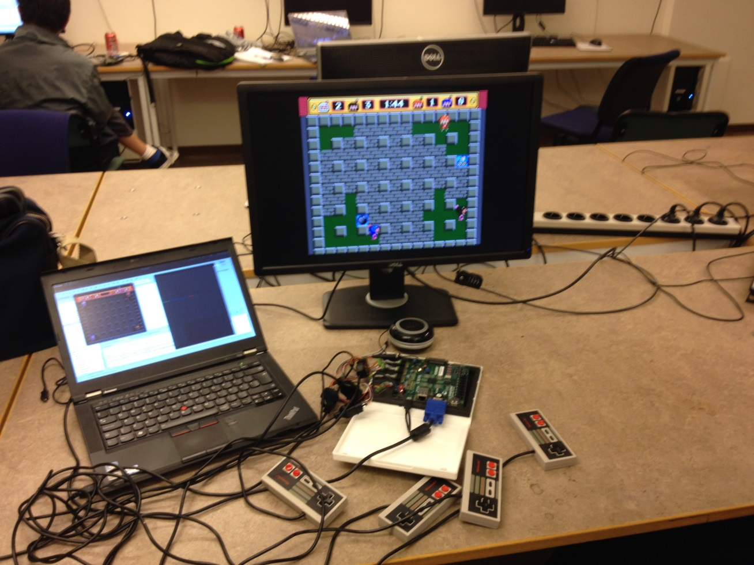
Questions?

