Slide 1
Proposal Presentation
Aircraft Combat (MINI Game)
Tan Siyu Miao Yun
10/9/2013

Slide 2
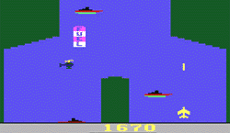
Demonstration of our idea

Slide 3
Block Diagram
Memory Block 1
(Stores instructions, score and status etc.)
Monitor
Keyboard
Keyboard
Controller
MicroBlaze
CPU
Graphic
ACC
VGA
Controller
Memory Block 2
(Stores status of Background)
Memory Block 3
(Stores status of Foreground)

Slide 4
Specification
1. Resolution: 640*480, 60HZ.
2. USB Keyboard.
3. Memories to store the foreground and background
pictures.

Slide 5
Improvements
1. A sound module could be added.
2. Add some more control methods.
3. Graphic improvements and add more types of enemies for the game.

Slide 6
Time plan
 | Tan Siyu | Miao Yun
Week 1 | Project planning | Project planning
Week 2 | Architecture design | Architecture design
Week 3 | VGA controller | Game logic design
Week 4 | Graphic accelerator | Software design
Week 5 | Other hardware | Software design & test
Week 6 | Final implementations | Final implementations
Week 7 | Report | Report

